Slide 1
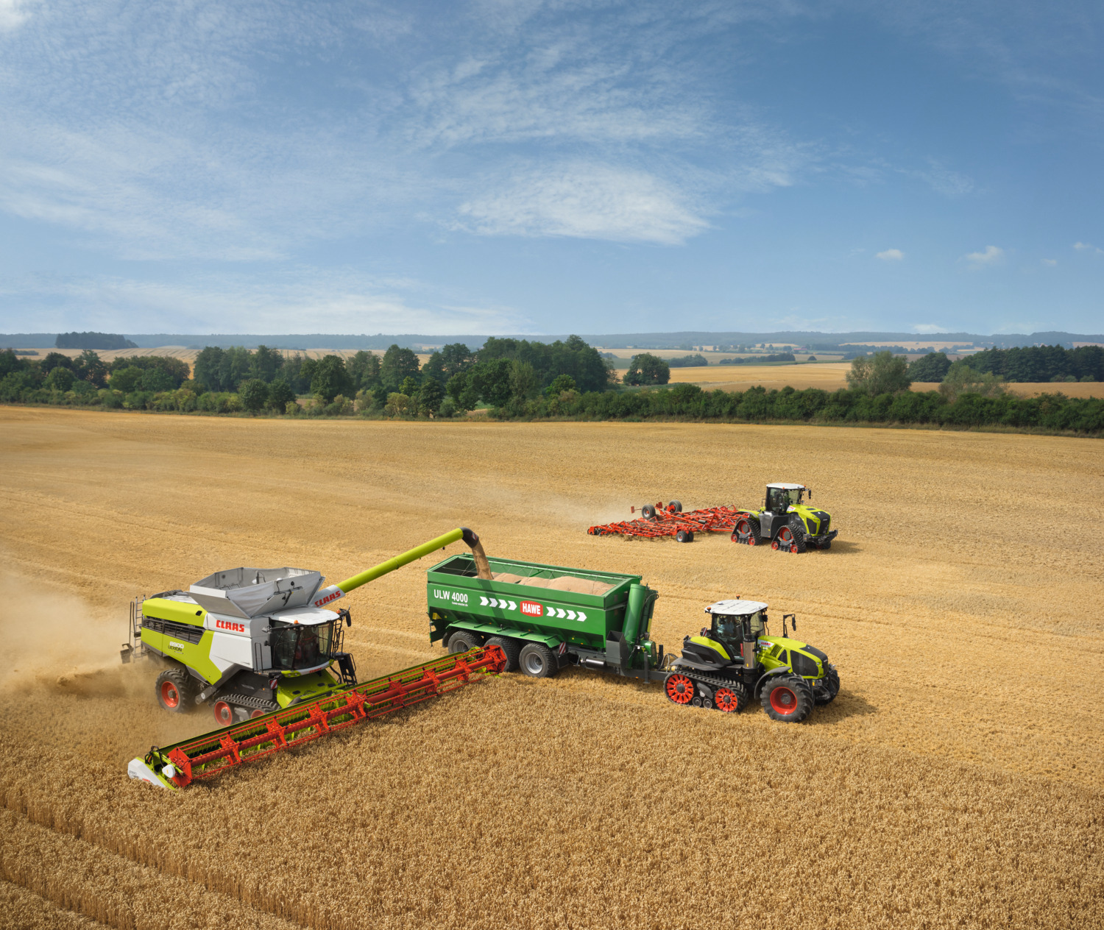
Sow, Grow and Farm
Zac and David

Slide 2
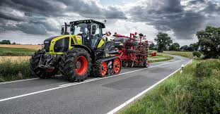
This PowerPoint is what we have learnt during our topic Sow, Grow and Farm, we hope you enjoy!

Slide 3

h
Fair Trade
Fairtrade is a company that makes buying and selling food easier at better prices, it is a world wide movement that aims to help farmers and producers in less economically developed countries.

Slide 4
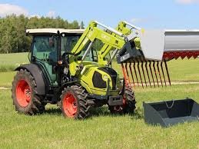
Modern Farming
Modern farming is the farming we do today
Like ploughing with satellite steering and GPS signals, you could have an argument lasting days about whether modern farming is better than older farming.

Slide 5
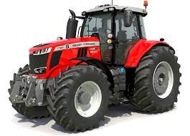

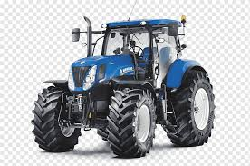


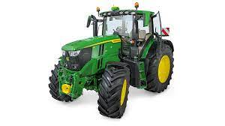
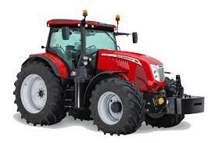


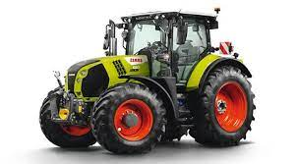
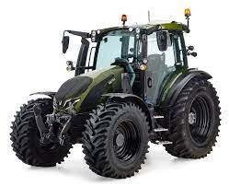


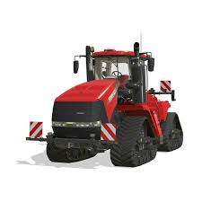

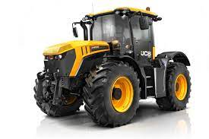

Slide 6
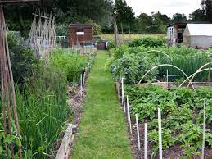
Allotments
Allotments are small pieces of land that people can rent out to grow vegetables and crops like raspberries and strawberries if they don’t want to\cant grow them at home, usually the allotment owners eat there produce but some sell them or use to feed animals.

Slide 7
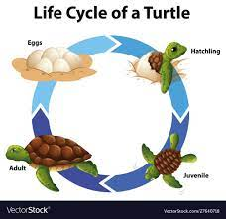
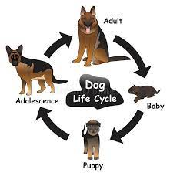
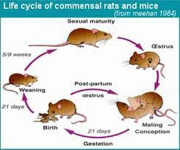
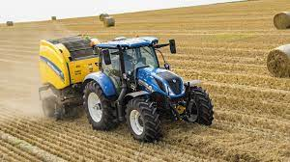
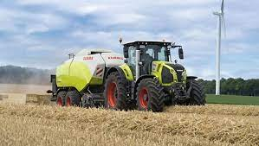

Slide 8
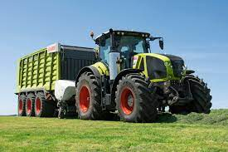
Land use in the UK
70% of the land in the UK is used for farming such as floriculture, arable, pastoral and market/commercial farming we are lucky we have all of this room for farming in such a small country.

Slide 9
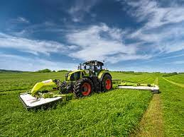
Grass work
Grass work is the work we do for our animals(cows mainly) we mow then ted or leave it we then windrow it, bale it and then feed our cows.

Slide 10
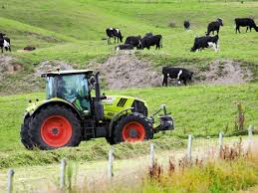
Cattle farming
Cattle farming is farming with cows as you can milk them or send them to a butcher to be killed for meat, so they give quite a good profit but cost a lot to keep.

Slide 11
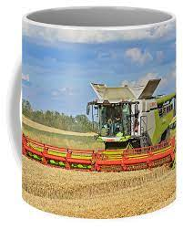
Coffee farming
Coffee farming is how me make coffee/farm it, it needs the right conditions meaning perfect temperature the best soil and much more that is why Peru is famous for growing coffee (it has the perfect conditions).

Slide 12
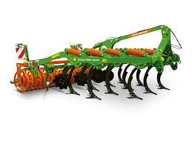
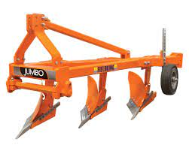
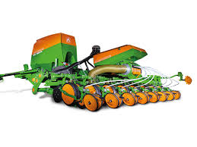
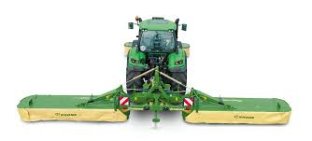
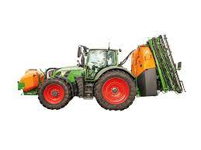
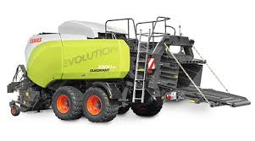
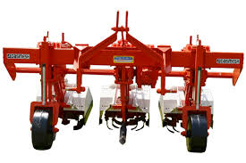
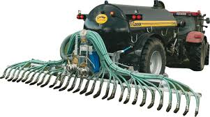
Cultivator
Drill
Sprayer
Slurry tanker
Plough
Mowers
Baler
Weeder

Slide 13
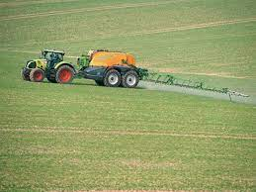
Why do we spray our fields?
We spray our fields so we can get a better yield and better crop so we get more money and so the food made with that crop tastes better.

Slide 14
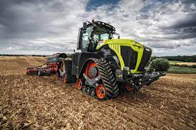
That is all we have learnt in this topic,
I THINK!
Have good one, BYE!

