Slide 1
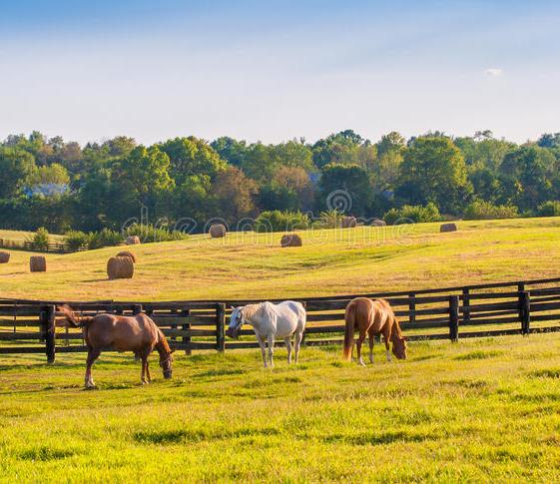
Sow, grow and farm.
By Isabella and Shelby

Slide 2
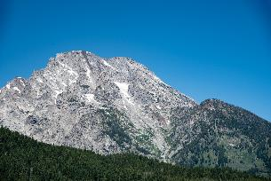
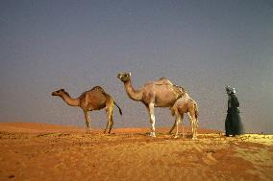
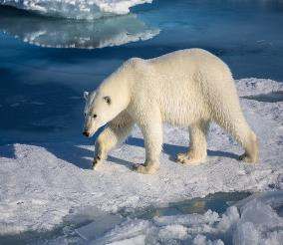
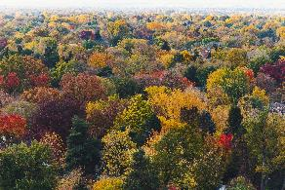
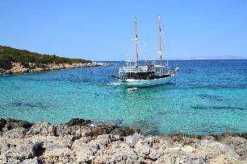

CLIMATE ZONES
Climate zones are areas of land of which have different climates depending on the zone. The climate zones are polar, temperate, Mediterranean, desert and tropical
There is also a mountain zone but it isn’t counted as a zone as the climate changes as you scale the mountain.
This Photo by Unknown Author is licensed under CC BY-SA-NC

Slide 3

Fair trade
Fair trade is a method of buying and selling goods that ensures the people who produce them receive a fair price.
Fair trade was introduced in 1994 as a way to ensure that all produce from farming is paid for fairly.
Some fair trade countries are …
Africa
South America
Central America
And so on.

Slide 4
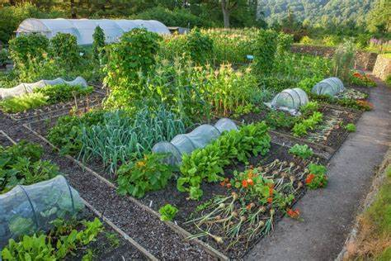
ALLOTMENTS
Allotments are plots of land (usually owned by the council)which are then divided into sections and rented out to individuals ,families or used for gardening purposes.
Allotments came from the dig for victory campaign in world war 2 because of food shortages.
You can grow fruit vegetable and sometimes even flowers and small animals such as chickens ,rabbits and bees.

Slide 5
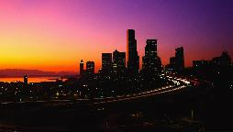
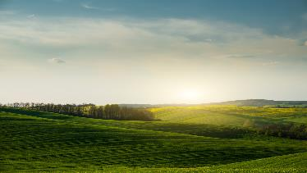
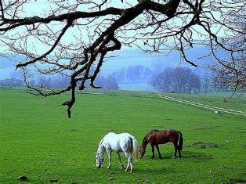
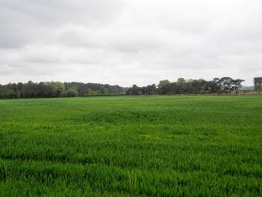
Land use in the UK
The are 9 land types but the main ones are….
Urban- which is used for Cities and towns.
Rural- Which Is used for national parks, villages, farming and forestry.
Pastoral- Which is used for keeping animals
Arable- which is used for farming crops.
.
.

Slide 6
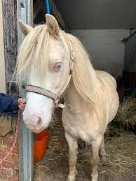
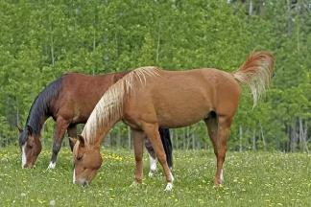
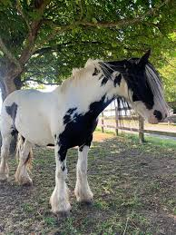
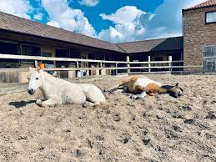
Horses and Ponies
Used for then…
Horses/ponies were used for ploughing fields ,pulling carriages ,to make themselves look wealthy, for other labour that people couldn’t do and sometimes even used in war.
Used for now…
Horses/ponies are now used for riding. People who own then like to enter compositions such as dressage, show jumping, racing and a lot more events! Some people use them for therapy to help lives. Also people use them for hunting or archery just for fun. If you are getting married you can have a horses pull your carriage.

Slide 7
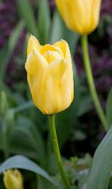
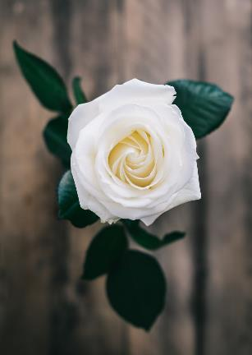
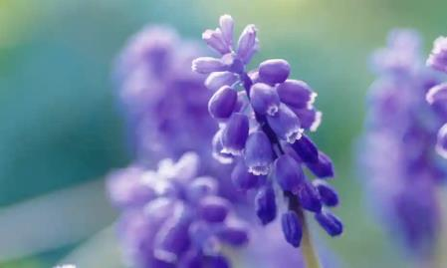
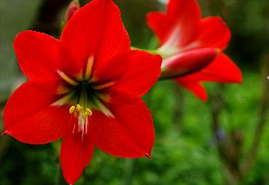
Floriculture
What is Floriculture?
Flower reproduction
Floriculture is a farm at which flowers are grown, harvested and picked to be sold.
Flowers reproduce in a process called asexual reproduction or sexual reproduction.
Asexual reproduction is when only one parent plant is needed.
And sexual reproduction is when two parent plants are needed as pollination needs two plants to pollinate and pollination produces plants.

Slide 8
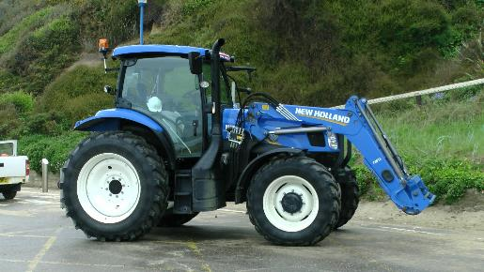
Thank you for reading the power point

