Slide 1
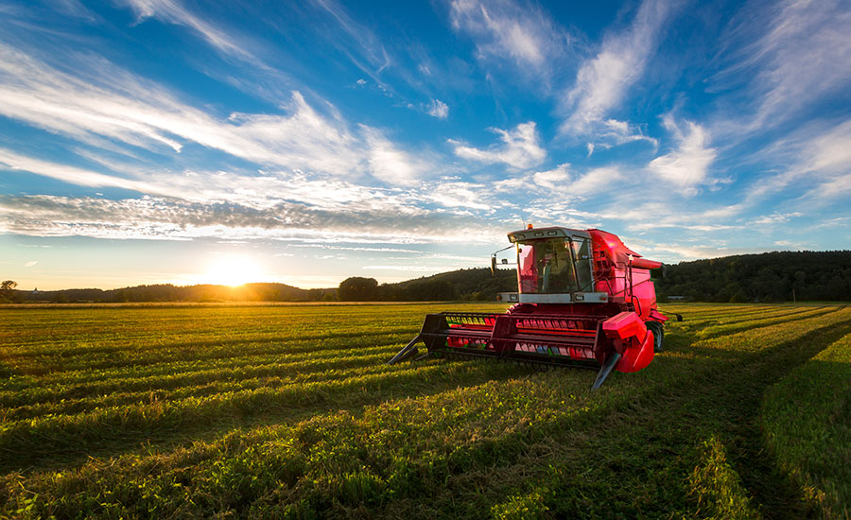
Sow, Grow and Farm
Maisie and Kiona

Slide 2
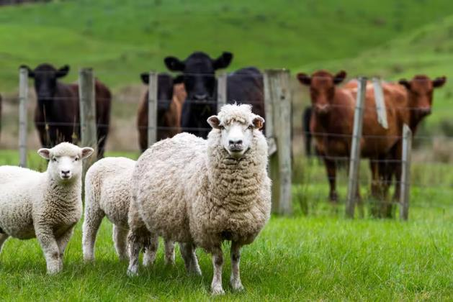
Our Big Question
Our big question is: What makes a good farm?
We think having good machinery, such as Tractors, Combine Harvesters, Transporters, and Cherry Pikers.
Also you might have to have crops. Farmers have to work every-day or every 2 days.

Slide 3
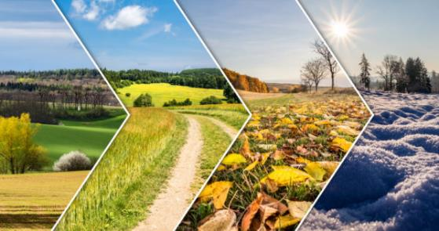
Seasonality
We have done some work on seasonality. Some of the facts are: Food that has grown had ripened naturally before being harvested is tasty and at its best. Local seasonal food will be fresher than food picked and transported from thousands of miles away. A foods nutritional value drops after it has been picked. Freshly picked seasonal food has more nutrition than food that has been picked and then transported over several days.

Slide 4
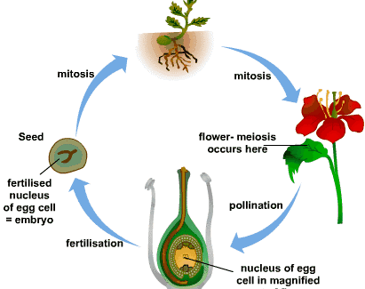
Sexual reproduction
Plant reproduction
We have done some work on plant reproduction here are the facts.
In sexual reproduction pollen is transported from one parent to another to create seeds that then grow into a new plant. The new plants are genetically different from their parents.

Slide 5
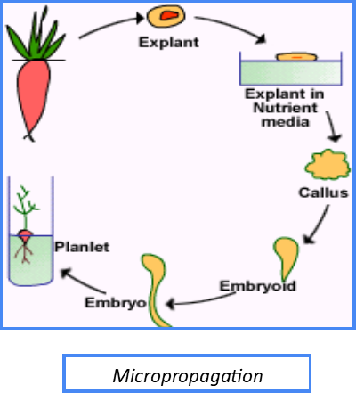
Asexual reproduction
Asexual reproduction includes only one parent plant. The plants can produce and identical version of themselves, called clones, that are genetically identical to the parent plant. There are different structures that enable asexual reproduction such as: tubers, runners, rhizomes, bulbs and corms.

Slide 6
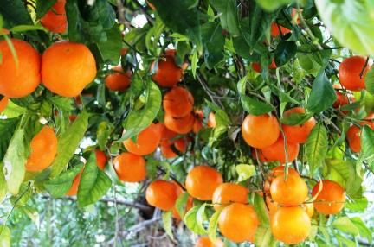
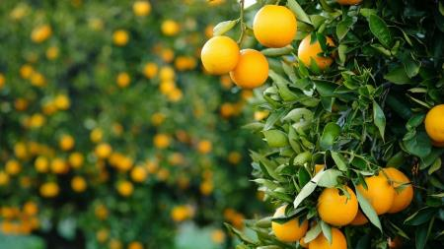
Citrus farming in California
California is one of 50 states near the pacific coast (west of North America). It has several deserts with coast lines and valleys that are ideal for farming one of which is the San Joaquin valley. With hot summers and mild winters, this makes it ideal for farming citrus fruits. Orange trees are propagated (grown faster) some orange trees are attached onto different stumps to make more fruits – this is called grafting. California is famous for oranges. The different types of oranges are: Navel oranges (grown from November to June), Verlinea oranges (grown from March to October), Cara Cara oranges (grown from December to May) and Clementine oranges (grown from October to January). 10% of oranges grown in California are sold to other countries such as: Canada, South Korea, China and Japan.

Slide 7

Fair Trade
Fair Trade is trade between two companies in developed countries and producers in developing countries in which fair prices are paid to the producers. Fair Trade has helped to keep 1.66 million farmers from low wages and poor workings conditions. Fair Trade has encouraged many farmers to farm in more sustainable and environmentally-friendly ways using fewer chemicals and effective irrigation. We can help by supporting fait trade and by buying fair trade products when we go to the supermarket. Our choices can make a big difference to the farmers’ and workers lives.
The Fair Trade Logo.

Slide 8
Modern farming vs Olden day farming
Modern farming
Olden day farming
New machinery
Technology
Scientific discoveries
Chemical pesticides
Synthetic fertilisers
Irrigation technology
Old machinery
No technology
Not a lot of scientific discoveries
No chemical pesticides
No synthetic fertilisers
No irrigation technology

Slide 9
Land use in the UK
Urban land is areas of land where buildings for businesses and apartment / housing estates. Rural land is where there are villages and large areas of farming land. Arable land is an area of fields used to grow crops. Pastoral land is an area of fields used to keep animals. Mixed land is an area of land where farmers grow crops and keep animals. Viticulture is where people grow grapes to be turned into wine. Floriculture is where people grow flowers or inside plants in glass-houses. Commercial farms grow food and look after animals that are then sold to supermarkets for the customers. Market gardens and allotments are grow fruit and veg that are sold, given away or eaten by the owner.

Slide 10
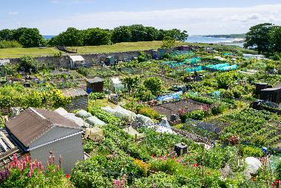
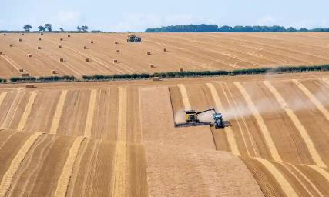
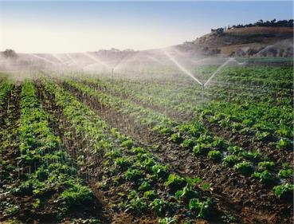
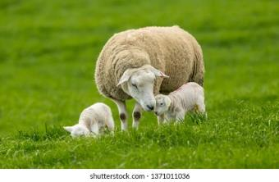
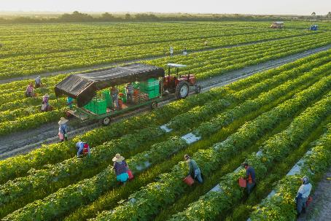
THE END

