Slide 1
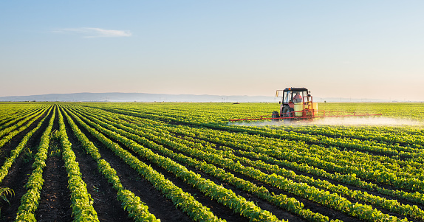
Sow, Grow and Farm presentation by Charlie and Jack

Slide 2

Fairtrade
Fairtade is a business that helps farmers get paid a fair price for the goods that they have. It also protects the environment and conditions that the farmers and workers work in. There are lots of products that are fairtrade. Although fairtrade products are a bit more expensive, it is worth it as it helps farmers all around the globe.

Slide 3
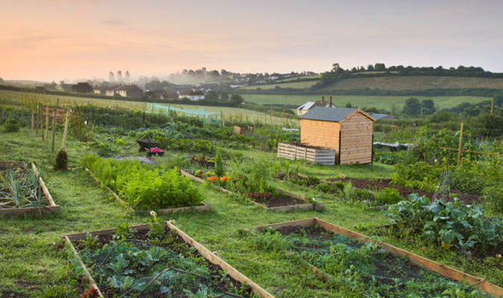
Allotments
What is an allotment?
Allotments are small pieces of land, often owned by the council. Individuals or families can rent these allotments to grow their own weekly fruit and vegetables. This will be better for your health and it will taste better as it will be fresh, and the price can be as little as £8 per year. It will be fresher as it won’t have any food miles.

Slide 4

Dig for victory
What was dig for victory?
Dig for victory was a campaign that was introduced in WW2. It encouraged people to make their own allotment, so the shops didn’t run out of food. This happened after the Germans started bombing, shooting down and attacking the food ships that came from different countries. Each year they got 24 coupons, instead of money, this also applied to the Royal Family.

Slide 5
Soil types
There are many different types of soil, loamy soil is particularly ideal for farming. You need soil to grow plants and crops.
Fun Facts:
.Any animal can help a plant by pooing and then you can spread the manure on the plant to help it grow. It can help with the chemicals and minerals in it.
Loamy soil: Soil that is amazing for farming and has everything that you will need for a plant to grow
Clay soil: Soil that does not let water out easily.
Sandy soil: Soil that lets water out easily.
These are the main types of soil.

Slide 6
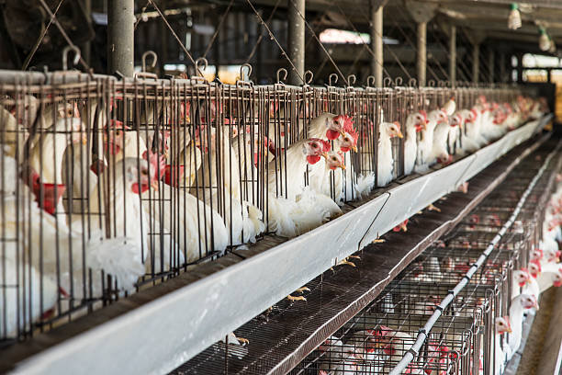
Battery farms
Battery farms can be good because they can hold lots of animals
however, when they put chickens in a battery farm, it is like torturing chickens. Also the chickens need freedom. When chickens are trapped in cramped areas, their eggs won’t be free range.
A picture of chickens cramped up in a battery farm.

Slide 7
Thank you for taking the time to watch our powerpoint.
The end.
☺☺☺☺☺

