Slide 1
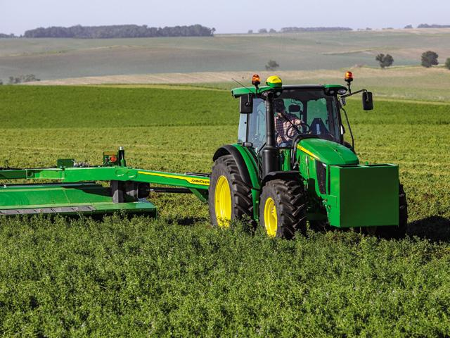
Sow, Grow and Farm.

Slide 2
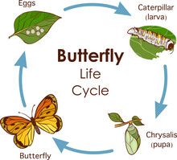

What is it all about?
This term our topic has been Sow, Grow and Farm. We have been learning about all different types of farming , including:
Allotments
Fair trade
Life cycles
And so much more!
This Photo by Unknown Author is licensed under CC BY-SA

Slide 3
Our big question!
This term our big question is , What makes a good farm ?
I think lots of things makes a good farm , but some things could be, lots of animals in one farm so everything is in one place. Also more than one person working on the farm so one person doesn't have to do all the work. It would also be a good farm if there were no houses because of the loud machinery and the foul smells.

Slide 4
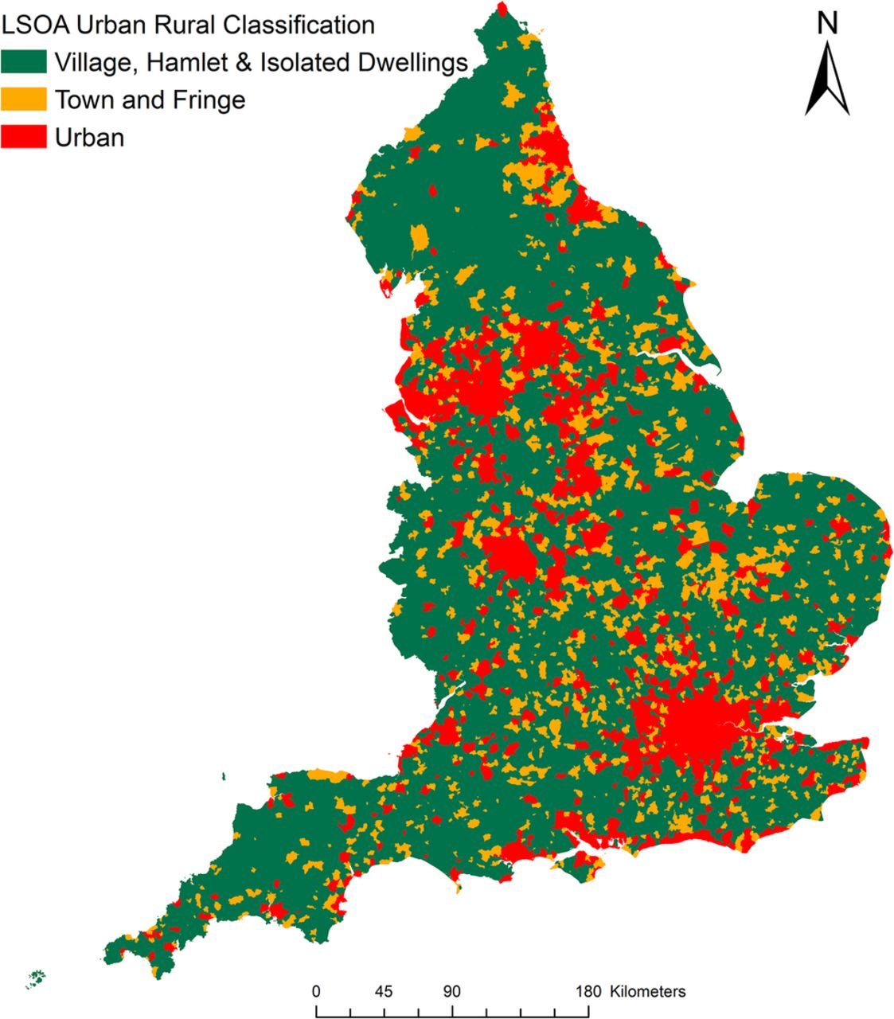
Land use in the UK
At the start of this term we learnt about land use ,some kinds of land use are:
Urban
Rural
Arable (fields for crops)
Pastoral ( raising livestock)
Mixed(arable and pastoral
Viticulture (grapes for wine)
Floriculture
Commercial farms
Market gardens
Allotments
This Photo by Unknown Author is licensed under CC BY-NC

Slide 5
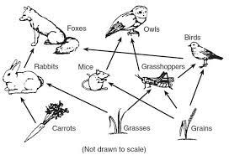
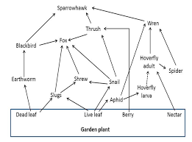
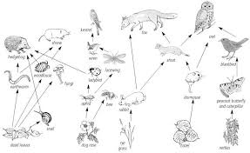
Food webs
At the start of the term we learnt about food webs. We looked at the food webs on an allotment.

Slide 6
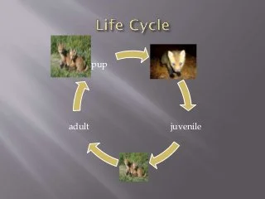
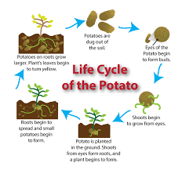
Life cycles
Fox
Potato

Slide 7
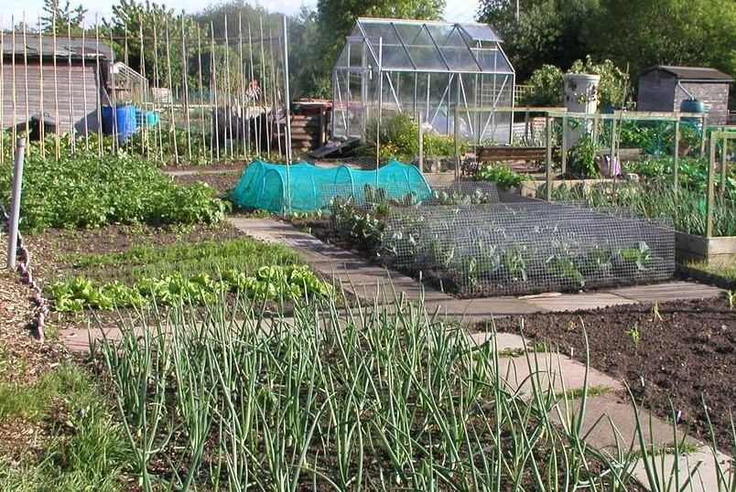
Allotments
An allotment is a big piece of land that is divided into little pieces that individuals and families can rent out. These allotments are often owned by the council. The public use allotments for growing food and flowers and raising animals such as, chickens, ducks, geese, pigeons, rabbits and bees. The cost of allotments range from £8 to £125 a year depending on the area .When you look for an allotment try to find one with these things :
A good water supply
Rich in nutrient soil
Good sun light
A owner who comes often
Close easy access
And so much more!

Slide 8
Seasonal Food
Month | Cabbage | Beetroot | Peas | Rhubarb
Jan | yes | yes | no | yes
Feb | yes | no | no | yes
Mar | yes | no | no | yes
Apr | yes | no | no | yes
May | yes | no | yes | yes
Jun | yes | no | yes | yes
Jul | yes | yes | yes | no
Aug | yes | yes | yes | no
Oct | yes | yes | yes | no
Nov | yes | yes | yes | no
Dec | yes | yes | no | no
Go to https://www.bbcgoodfood.com/seasonal-calendar to find out more information on seasonal food.

Slide 9
Pros and Cons of Veganism
Con
Pro
More expensive
Meant to eat meat
Not the best food
The diets low in protein and fat
There isn’t many only vegan restaurants
Less animals die
Lowers your carbon footprint
Reduces the risk of some illnesses
Encourages other people to lower the amount of meat they eat
You can make a difference for many animals (105 a year)

Slide 10

Fair trade
Fair trade is a method of buying and selling of goods that ensures that the producer has received a fair price and have been treated correctly. They make sure workers get their rights and are no exposed to anything in their harm. Some fair trade items are : flowers, sugar, tea , cotton, wine , rice , bananas , coffee, chocolate and so much more. For more information go to Fairtrade Foundation: https://www.fairtrade.org.uk/ .The fair trade foundation offers training for farmers so they can get a better wage.

Slide 11
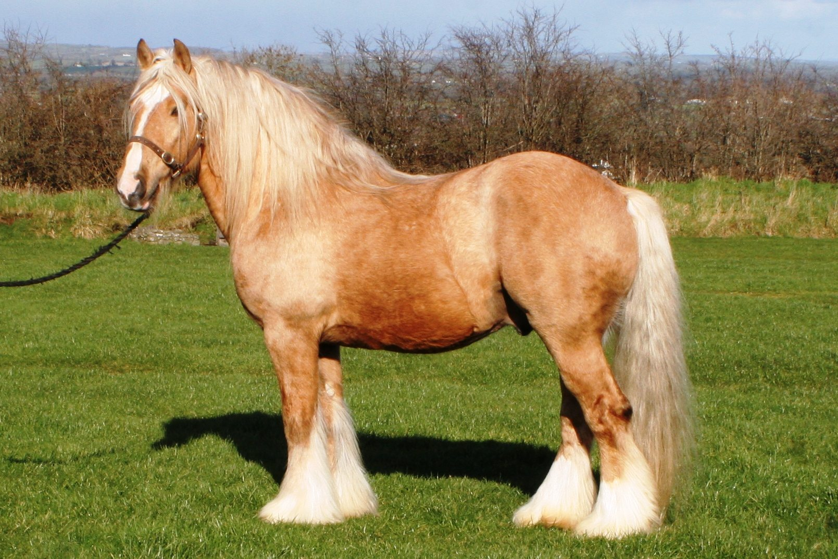
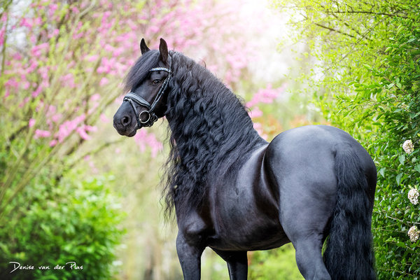
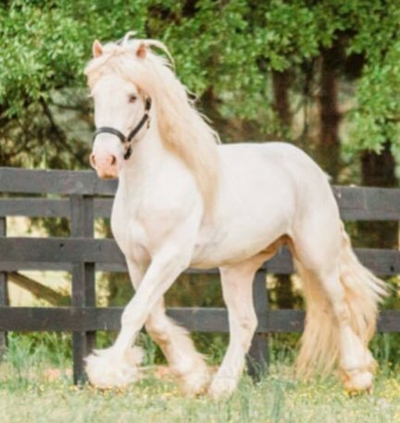
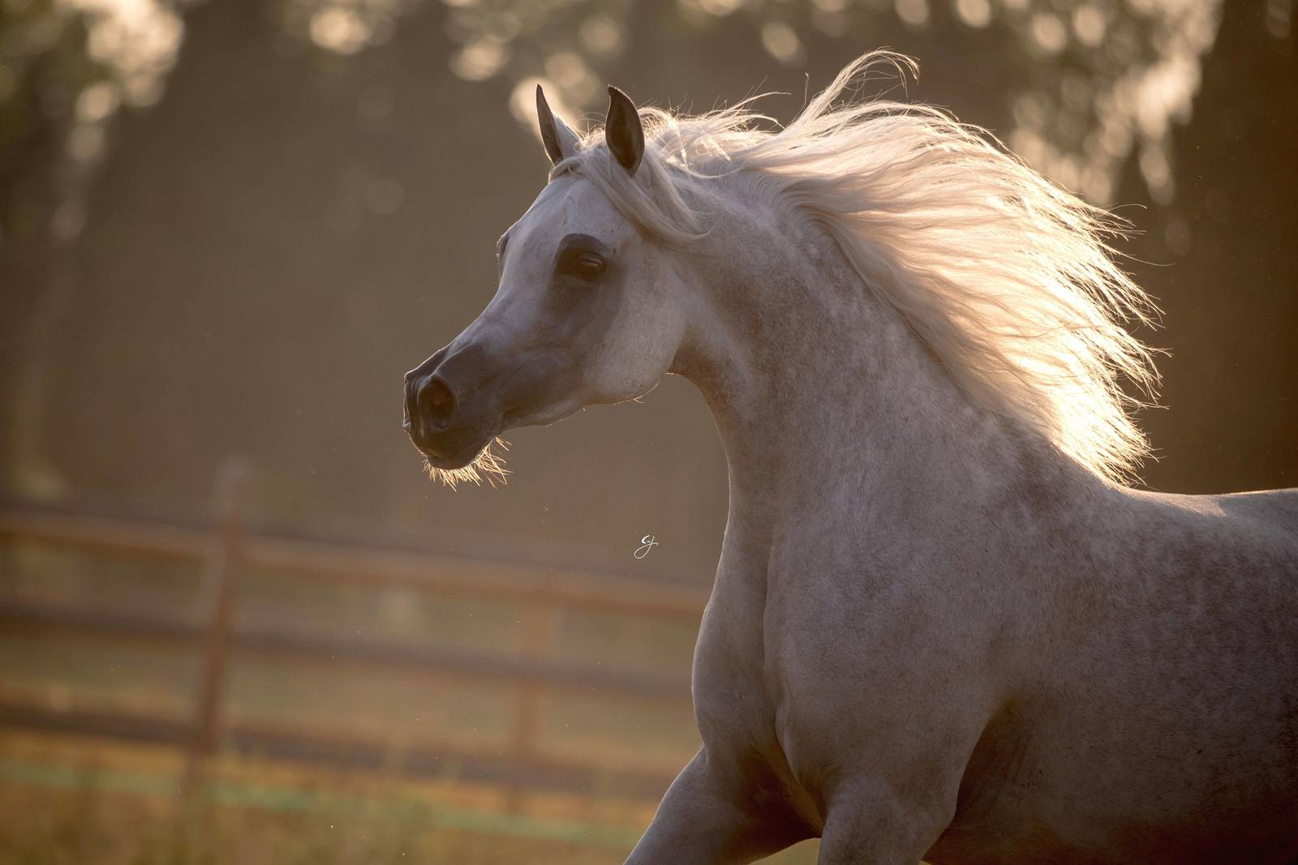
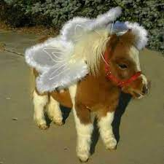
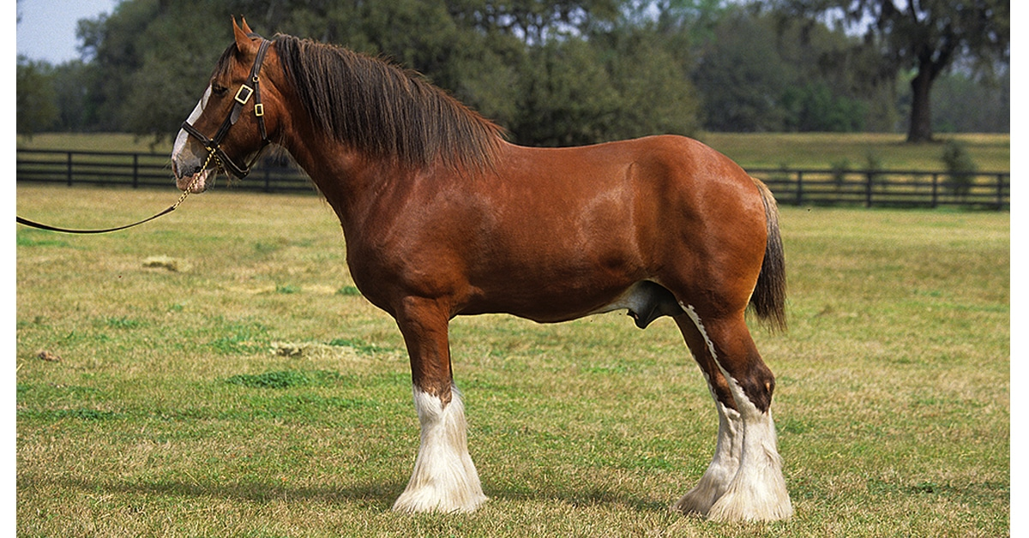
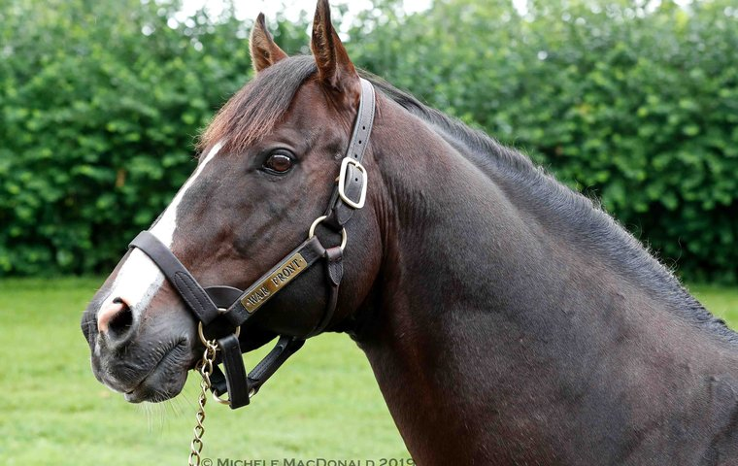
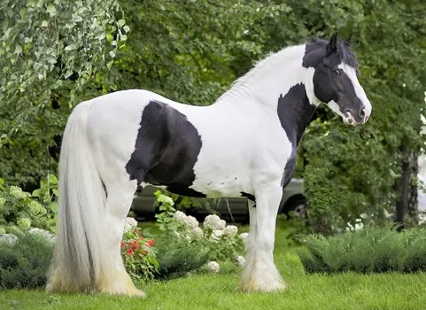
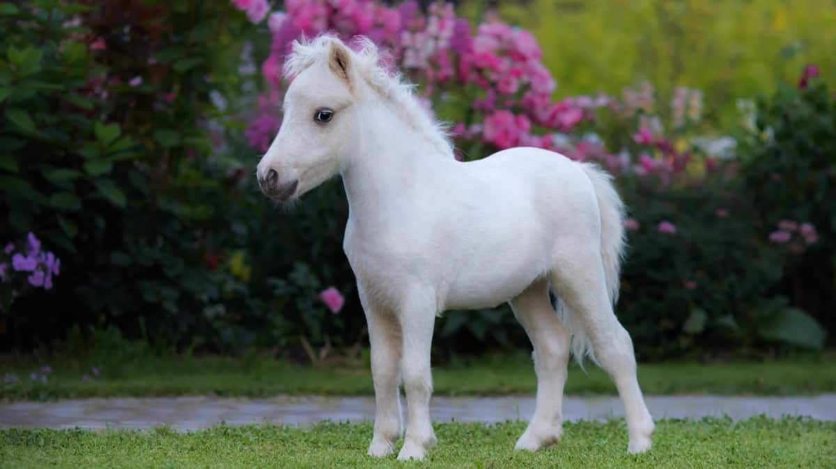
Horses

Slide 12
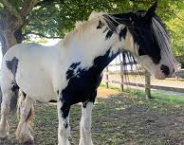
Horse info
Horses are great on farms because you can sell/loan them which brings in a lot of money .If you have the room you may be able to make a school .A very popular idea is to make the stables public so people of the public can keep their horses there.

Slide 13
Thank You For Watching !
Hoped you enjoyed!
From Emily and Bonnie

