Slide 2
#WeStandWithUkraine
Ukraine Forever

Slide 3
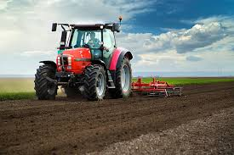
Sow, Grow and Farm
By Riley and Leon
In the sow, grow and farm topic we learnt all about farming.
On Wednesday 20th April 2022, we learnt about land use in the UK. The types of land use in the UK are urban land, rural land, arable land, pastoral land, mixed, viticulture, floriculture, commercial farms and market gardens.
On Thursday 21st April 2022, We learnt about allotment food webs and the life cycle of foxes and frogs.
On Tuesday 26th April 2022, we planted types of vegetables of our choice in a group of three. We had to fill our pots with soil, then we had to plant the seeds into the soil, then put more soil on the top, finally we had to water them.

Slide 4
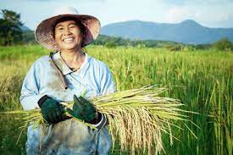
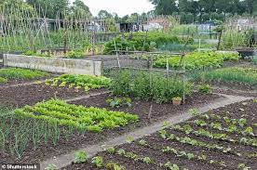
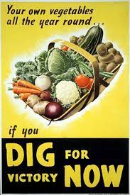
On Wednesday 27th April 2022, We planed our allotments fact files. Some of the questions that I wrote down were, When did they start, What are they, What tools are needed and What makes a good allotment.
We also did ‘Dig For Victory’. Dig for victory took place in world war two because of food shortages. If you were so desperate for food then you would’ve used your coupon to buy some.
Then on the next day (Thursday 28th April 2022) we did our allotment fact files. For me it turned out to be a very good fact file.
On Tuesday 3rd May 2022, we looked at a diary of a Suffolk farmer. We read at the diary and looked for diary features. The main feature we could all find was paragraph’s of cause.

Slide 5
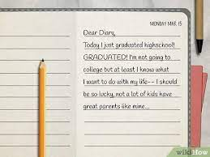
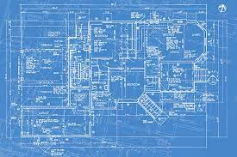
For this week we learnt more about Diary's
On Tuesday 3rd of May 2022, we wrote about a farmers year. It was learning how a farmer works and the conditions they work in. We did all about summer, winter, autumn and spring.
Then the next day, we did our plans for the diary’s. We had to write down little notes for month/paragraph.
When we did our diary’s, it was one of the best that I’d ever wrote.

Slide 6

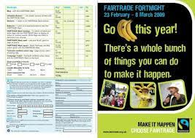

On Tuesday 10th May 2022, we did features of a leaflet. We had to do the title, Introduction sub-title, facts, and then writing features that we could of get in. Such as Imperative verbs, modal verbs, topic words and more.
We also had to do a glossary.
Then on Friday, we did our leaflets about Fairtrade. I believe I did very good, it turned out better than I thought.

Slide 7
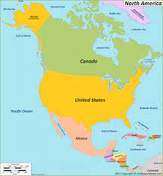
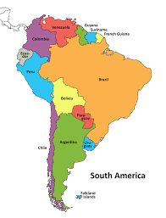
We learnt about farming in North and South America. It was about what different types of farming North and South America do.
South America have the perfect climate to make coffee beans.

Slide 8

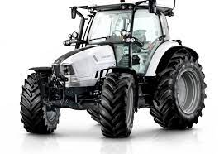
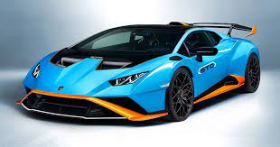
This is a Lamborghini tractor made by the Lamborghini car brand.

Slide 9
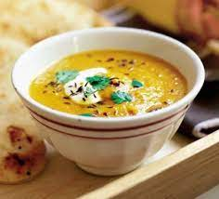
Spiced Carrot Soup
We made recipes of spiced carrot soup. Spiced carrot soup looks like this
=

Slide 10
The End
Thank you for watching my slide show

