Slide 1
Sow, grow and farm
In this topic we have been learning about farming and all its elements. In this presentation you will learn all about farming.
By Ollie and Marshall.

Slide 2

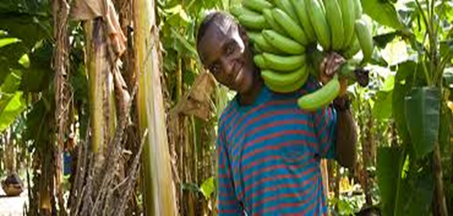
A picture of the fair trade foundation logo
Fait trade is an organisation that help poor farmers get the correct payment they need to life.
Some fair trade product are: tea, coffee, banana’s, sugar, flowers and chocolate. Some other products are cotton, fruit, nuts, wine and many more.
Some fair trade facts.
1. Join your local fair trade community.
2. Chose fair trade food at café’s and restraints to help a little bit more.

Slide 3

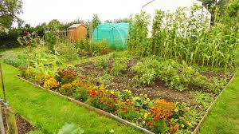
A picture of an allotment logo
An allotment is a small piece of land which you can grow vegetables, fruits and flowers. An allotment normally coast £8 to £125 and can normally be rented for long periods of time
Glossary
Carbon footprint
The amount of carbon dioxide produced.
Council
The group of people elected to govern area.

Slide 4

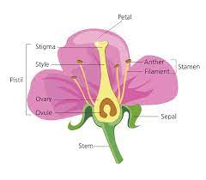
Flower reproduction.
Sexual reproduction
Sexual reproduction is when you use 2 plants to reproduce a new plant. It takes 2 plants and a bee to be able to do sexual reproduction.
Asexual reproduction
Asexual reproduction is when only 1 plant is involved. Then the plant an identical version of its self ( called a clone) that are genetically the same as there parent.

Slide 5

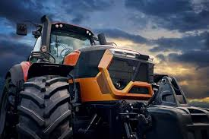
A modern tractor.
Some tractor names
1. John deer tractor,
2. Lamborghini tractor,
3. New Holland tractor,
4. CLAAS tractor,
These tractors are what modern day farmers use every day to help them with there farming jobs.

Slide 6

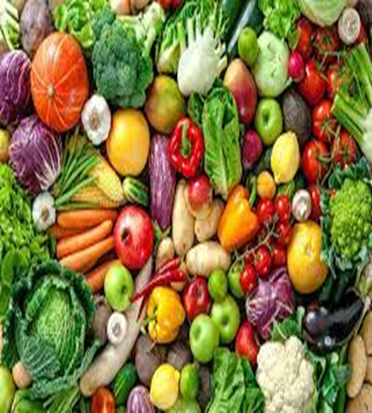
A picture of vegetables
Fruit and vegetables keep us alive every day because of there nutrients and protein.
Some vegetables …..
peppers, apples,
broccoli, bananas,
carrots, pineapple,
Peas, pear,
And many more.

Slide 7



Thank you for reading are power point all about Are topic sow grow andfarm.
Marshall and Ollie!!!!!!
THE END !!!!!!

