Slide 1
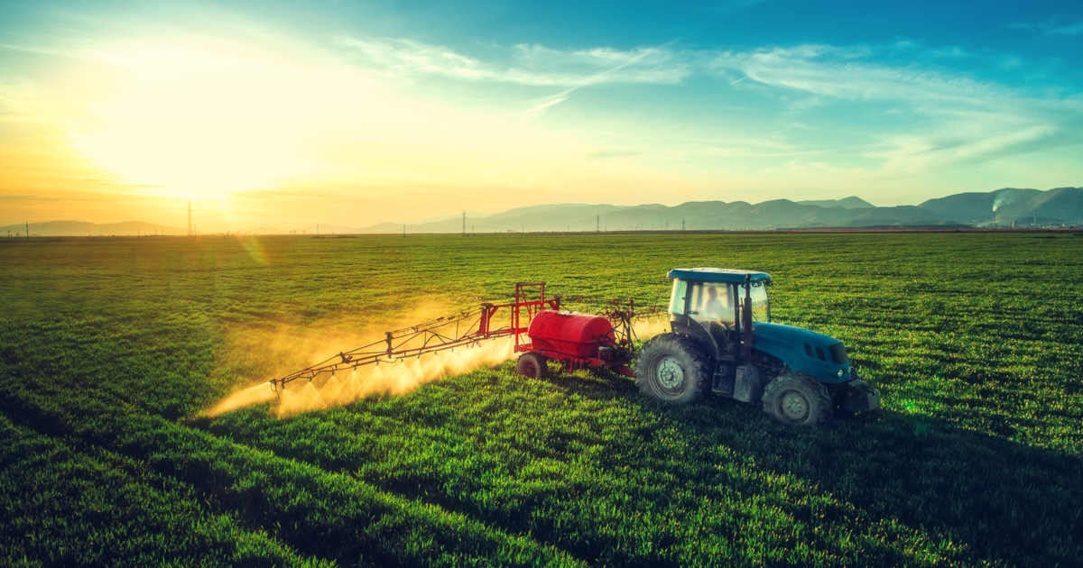
Sow, Grow and Farm
Farming land
There are a lot of different types of farming around the world. Types of areas, land used for types of farming, there is a lot! And even the temperatures to grow food. You need to be in a hot , cold , rainy place ( depending on what your going to grow). Also, you may need hilly or flat land for different types of farming, like…Pastoral farming and Arable farming!
By Brooke and Briar ☺

Slide 2

Dig for Victory
Dig for Victory persuasive poster
Facts
People made persuasive posters for people to grow their own vegetables because there was no food left in shops.
There was a lot of posters around in Britian.

Slide 3

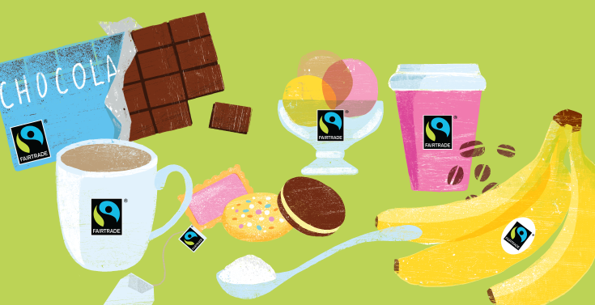
Fairtrade
Fun Fact
We eat 8 billion bananas every year ( in the UK).
Fairtrade Products
. Bananas
. Chocolate
. Coffee
. Flour
. Sugar
. Cotton
(ECT)
Fairtrade Products

Slide 4
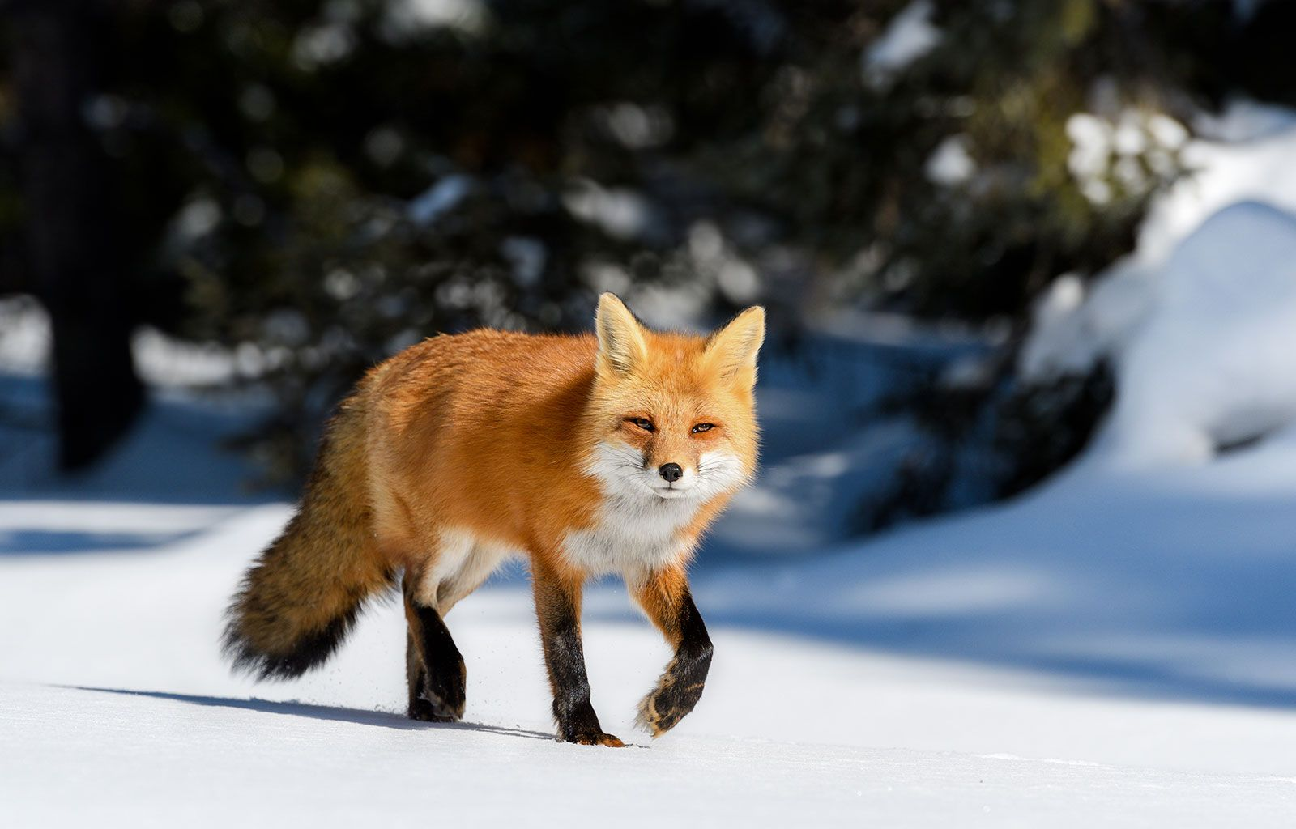
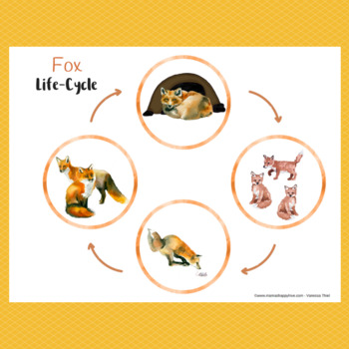
Life cycle of a Fox!
This is a fox, we are going to talk about its life cycle!
Foxes, who are in the wild, mostly live up to 3-4 years, but in captivity, Foxes can live up to 14 years!

Slide 5
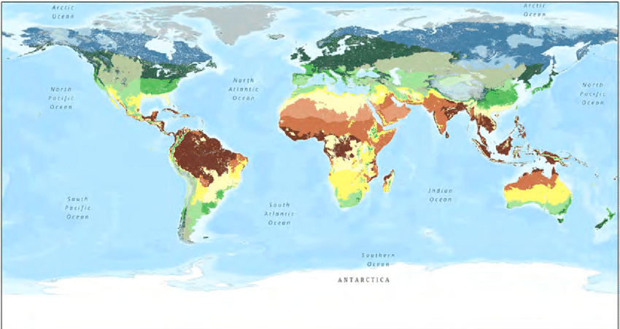
Fun Fact
Climate Zones
There are 5 different climate zones, they are the Polar, Temperate, Mediterranean, Desert and Tropical Zones. Also most of Europe has a temperate climate, and the UK has the same. In Africa, it mostly has boiling hot conditions, and sometimes our own food is grown there! Countries and Continents like Antarctica , Russia and Canada (ECT) live in such snowy conditions, like below 0 degrees!

Slide 6
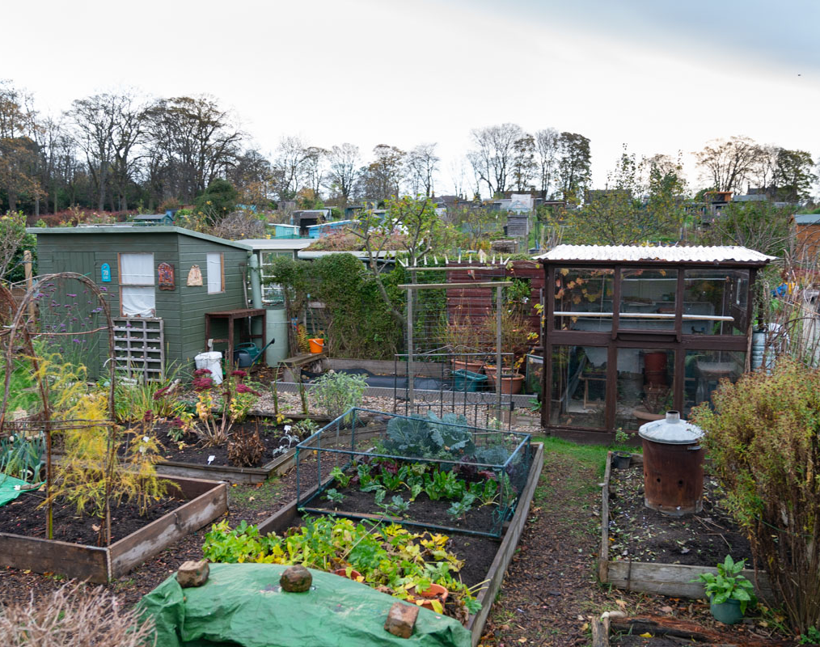
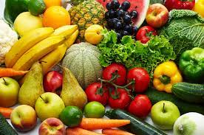
Allotments
Allotments are small pieces of land that people can rent from the council or their Landlord. Their food isn’t for the public, they normally keep the food to themselves or family members. They were invented from the Saxons,( Anglo Saxons) for more poorer people to grow their own food and stay alive, they usually grown fruits and vegetables.

Slide 7
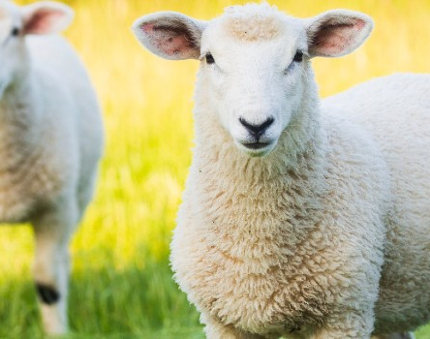
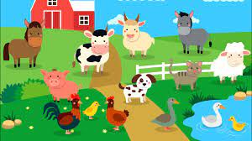
Farm Animals
Farm animals are usually cows, sheeps, chickens, pigs,(ECT). These animals provide resources such as wool, meat, eggs, (ECT). A lot of people in the UK live/own farms, because it’s a pretty Rural country!

Slide 8

THE END ☺

