Slide 1

2024-2025
Notes:
Cycling

Slide 2
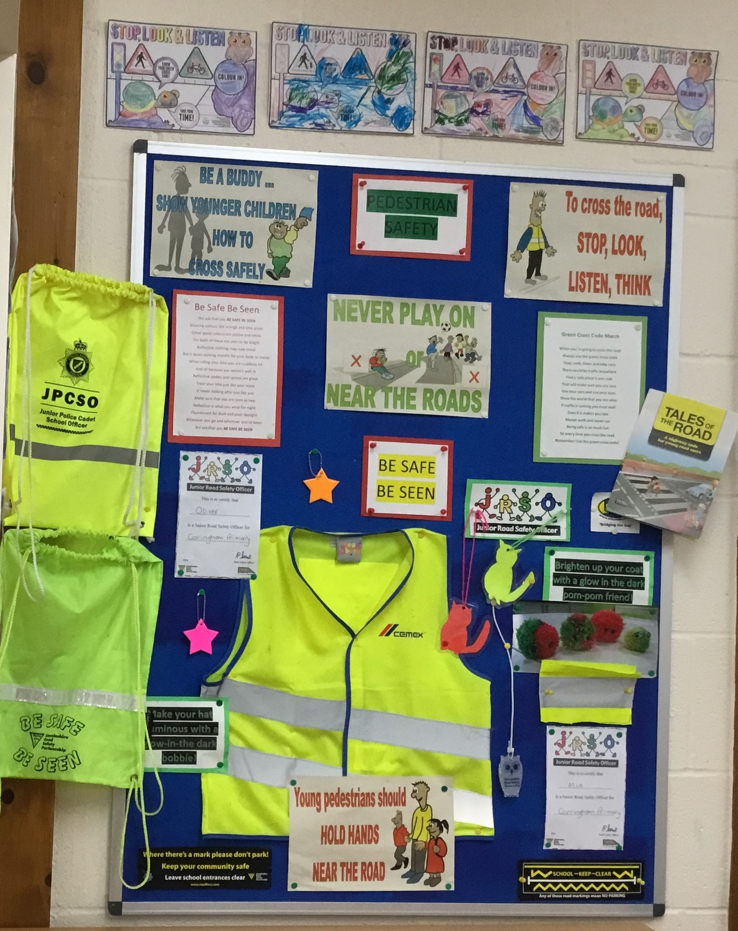
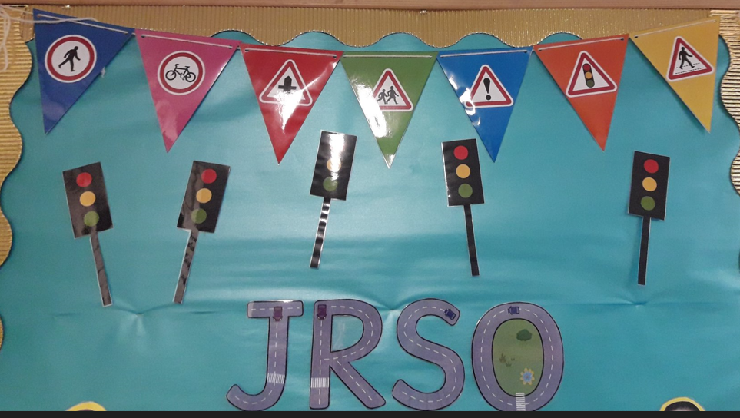
Welcome!
An introduction to your role as JRSO!
Congratulations on your new job as Junior Road Safety Officer (JRSO) for your school.
JRSOs are an important link between the Education Team at Lincolnshire Road Safety Partnership (LRSP) and your school.
Our aim is "Working Together to Make the Roads of Lincolnshire Safer for All".
As a JRSO your role is to help everyone at your school learn more about and understand the importance of Road Safety.
Your task is to organise road safety initiatives e.g. participate in themed assemblies, run competitions, and promote road safety to the wider school community via notice boards and displays, newsletters, posters or social media / internet.
School will provide an adult to support you as JRSOs, please make sure you find out who this is.
Notes:
Cycling

Slide 3
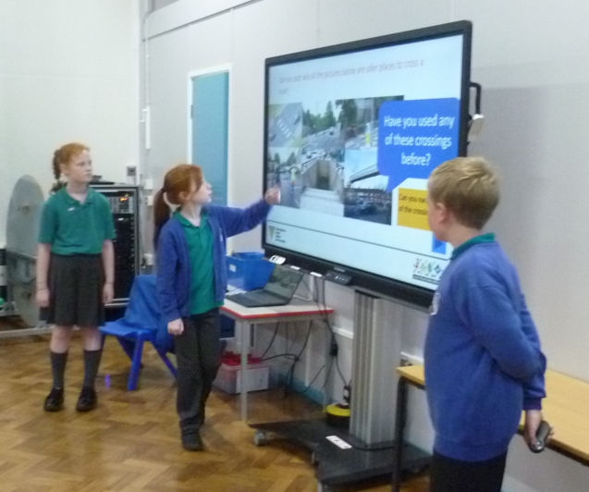
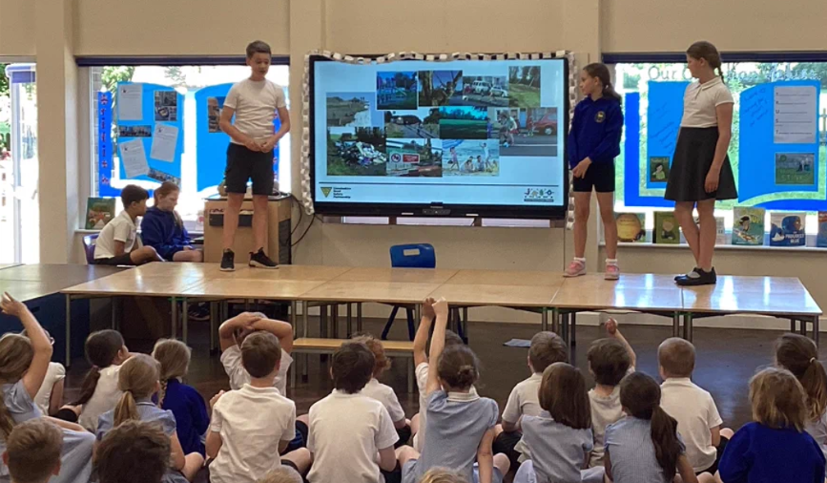
Promoting Road Safety
What can you do in your school to help?
Assemblies
An assembly is a very good time to give out road safety messages as everyone is together. You could plan a whole assembly or just ask for part of it to tell people about a competition, give out prizes, or read a road safety story or poem or even sing a song!
Take a deep breath & don't panic.!
• Practice first before the assembly.
• Make sure you have everything you need.
• Read/ speak slowly and clearly (don't rush).
• Try to look at your audience occasionally.

Slide 4
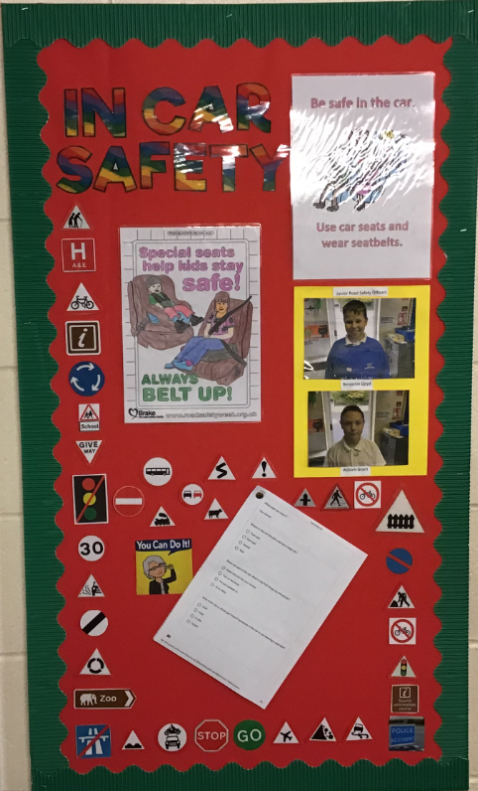
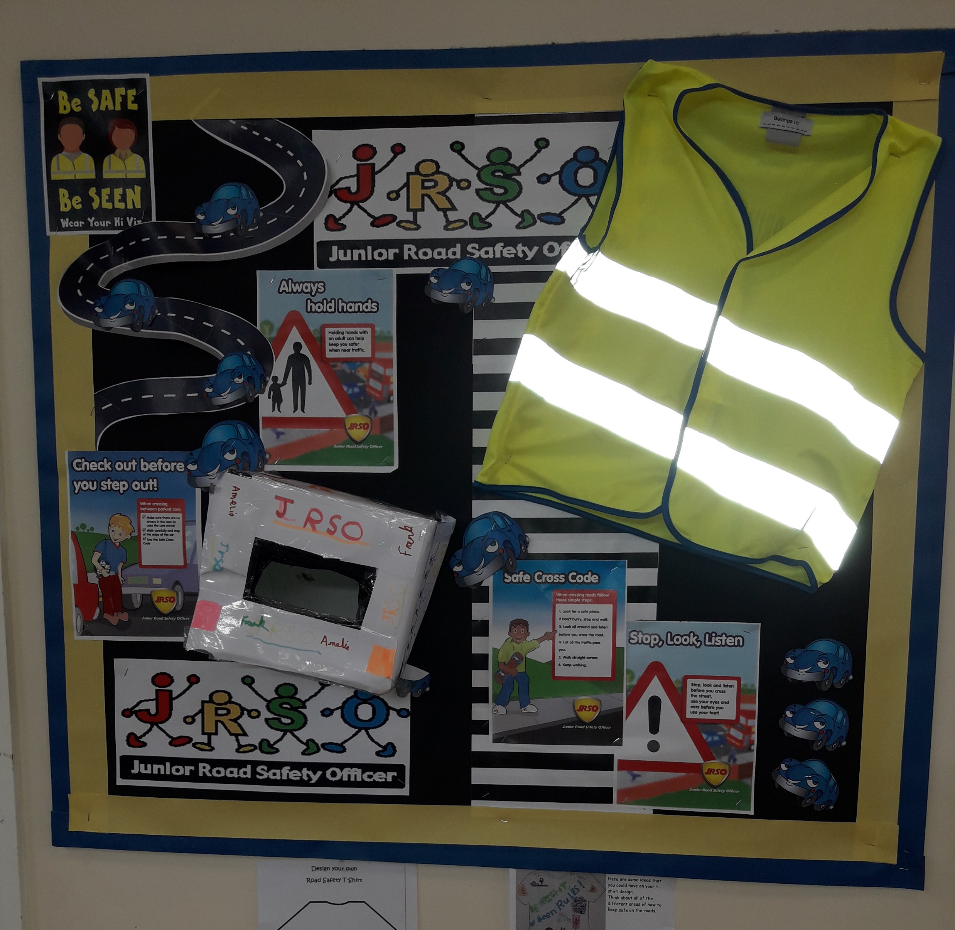
Promoting Road Safety
What can you do in your school to help?
Notice Boards and Displays
This is an effective way to display road safety information and messages and promote your JRSO activities.
You need to ensure that this is somewhere where it can be seen.
Make sure it is clear, bright and attractive so people will look at it.

Slide 5
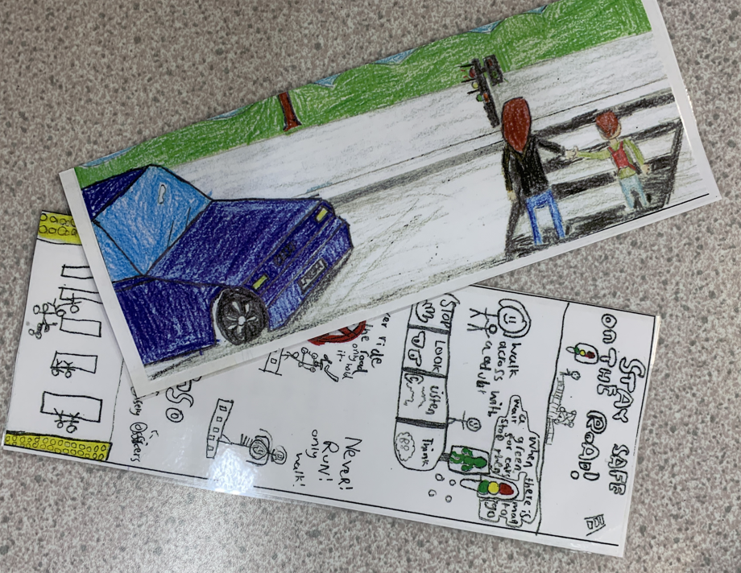
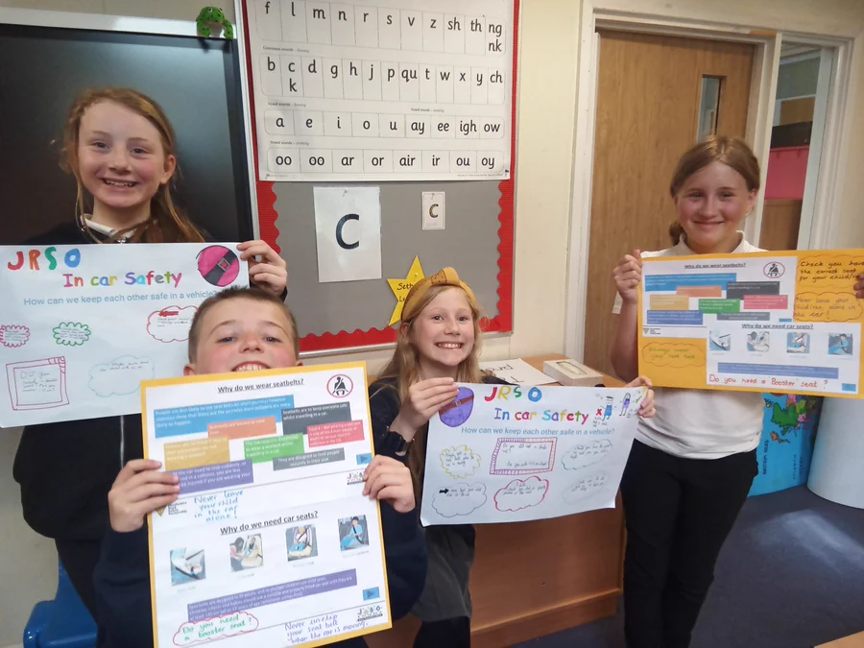
Promoting Road Safety
What can you do in your school to help?
Competitions
Competitions are a great way to involve everyone in thinking about Road Safety.
You could create a competition to design a poster, write a poem, colour a picture, a word search, crossword, quiz or produce a Road Safety video clip or jingle. Make sure it is suitable for the age of the children; you may set different competitions for Foundation Stage, Key stage 1 and Key Stage 2.

Slide 6
Here are some suggestions to help you run successful competitions:
Make sure everyone knows about your competition, you could announce your competition in assembly or ask class teachers to tell each class during registration.
You will need a prize for the winners, ensure everyone knows what this is. It could be something like a pencil, reflector, sweets etc. or maybe House Points or a treat from the Head Teacher. Discuss this with your adult support – they may even help you write to local shops, or businesses or ask Friends of School / PTA to help.
Make sure everyone labels their entry with their name and class (ideally on the back)
Ensure everyone knows how to submit their entry. Have a place (e.g. a box) where entries should be put or arrange to visit classes to collect them.
Set a closing date and make sure you remind everyone when it is nearly finished.
Choose winners fairly, always ask your adult support to help. Who will you choose to present the prizes?!

Slide 7


@JRSO_Lincs
Keeping in touch!
This is a quick and easy way to get Road Safety messages and information to parents, families, friends and your local community.
Use your school's website, X (twitter) or other social media platforms to spread news about JRSO's and Road Safety.
We also have a dedicated X (Twitter) page (@JRSO_Lincs) for JRSOs across the county to use so ensure you tag us in and share your ideas and successes and support each other.
Don’t forget to tag your Road Safety Officer in too ( @RSO_Sam)

Slide 8

@JRSO_Lincs
Keeping in touch!
Newsletters
Want to see your school make the news?! Termly newsletters are sent out to Lincolnshire Schools with all the current Road Safety news and updates.
You have the chance to share you’re your work and achievements by writing your own articles to include it!
Your school may also create their own newsletter. If they do, ask if JRSOs can have their own section, you can then use this to tell people about the great work that you are doing!

Slide 9
JRSO THEMES
Your focuses across the year!
To successfully complete your time as school JRSO’s, you will need to cover the following 3 Termly themes.
Autumn Term: Pedestrian Safety
Spring Term: In Car Safety
Summer Term: Out and About
If you and your schools register as JRSOs in the Autumn Term then your first theme will be Pedestrian Safety. If you become a JRSO in the Spring term your first theme will be In Car Safety. If you become a JRSO in the Summer Term, your first theme will be Out and About.

Slide 10
Next Steps
What should you do next?
Your local Road Safety Officer, Sam Smith, will send your first themed JRSO PowerPoint pack. This pack will contain all the information and support that you need to deliver road safety awareness in your school!
Organise some time to sit with your designated adult school and work through the PowerPoint presentation.
Should you have any queries or need any further help Sam will be happy to chat with you. Email: samantham.smith@lincolnshire.gov.uk

