Slide 1
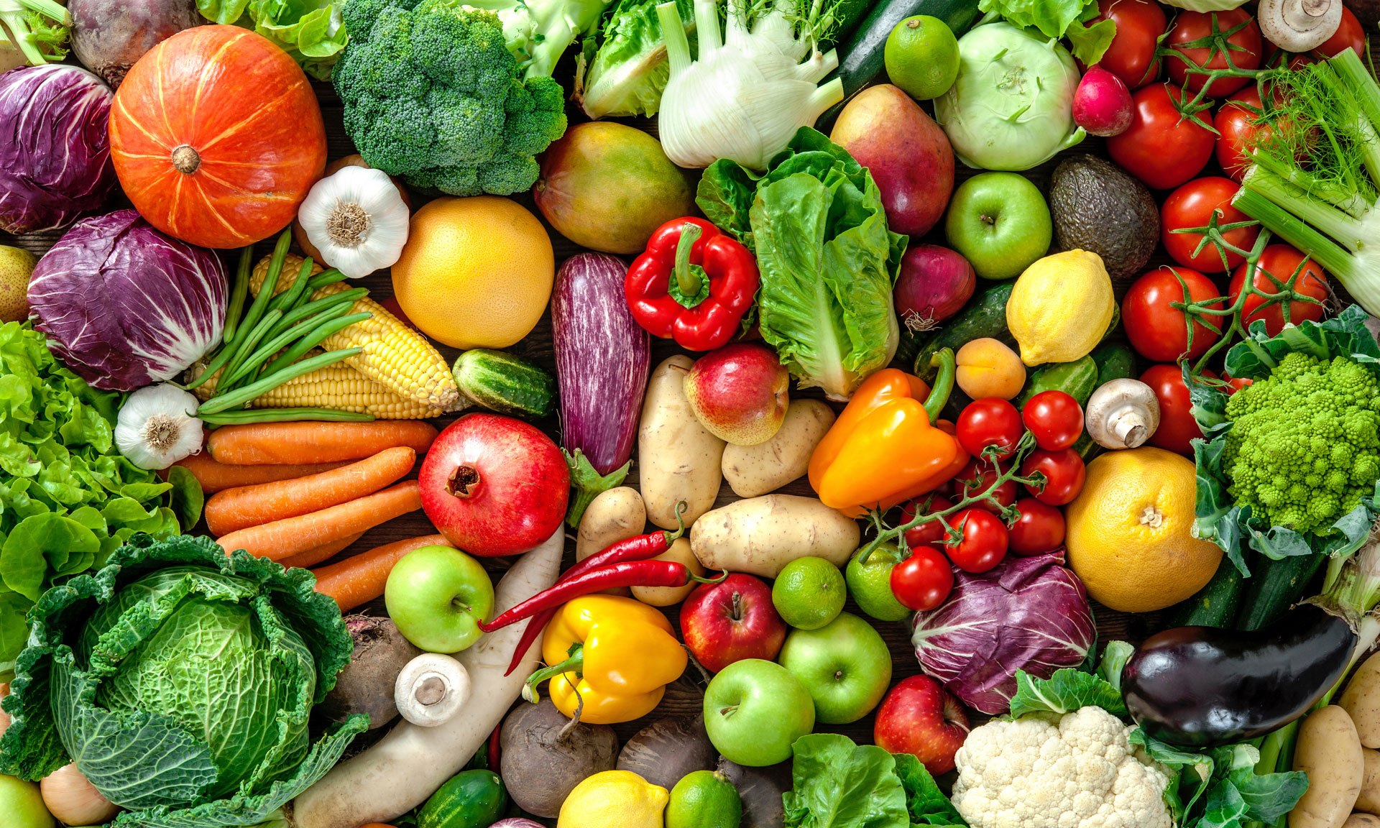
Sow, Grow and Farm
What makes a good farm?

Slide 2
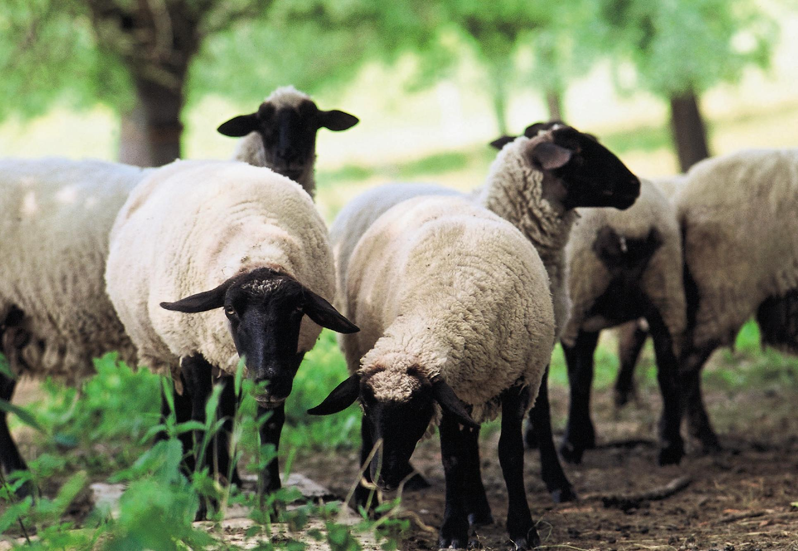
Animals , climate and modern farming
Animals live on different types of farms, they are called pastoral and mixed. The most common farm animals are cows, sheep ,pigs, , horses, goats and more.
There are 5 different climate zones they are called polar, temperate, Mediterranean, desert and tropical.3 of these climate zones are major, polar, temperate and tropical.
There are 2 types of modern farming, pro and con this is what they are.
pro
pro farming is better farming, it included removing hedgerows to increase the size of fields which makes farming easier. Autumn planting is if you plant crops in autumn instead of spring to make yields higher. Monoculture is where you only grow one type of plant to make it easier to sow the seeds , control weeds and harvest the crops. Irrigation technologies is used for plants to grow undercover or in a place little rainfall. There are many more but these are
Just a few
cons
The cons about modern farming are…
.one of the cons are that if you plant a single seed you have a chance that not all of it will grow.
. Modern farming is bad for the environment
. When you use modern farming and chop down hedges animals could loose their home
. There are many more but these are just a few.

Slide 3
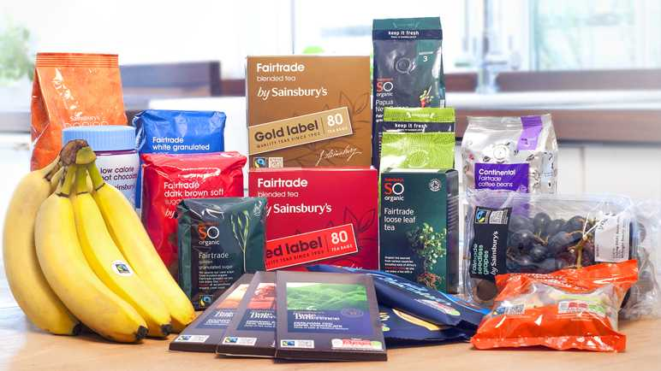

Fair trade
Fair trade is where you sell products for a good price such ad coco beans, bananas, flowers, fruit and more.
Fair trade has been going on since 1994 which is 125 years . only 93% of people notice the fair trade symbol when going shopping.
over 19 million farmers were apart in the fair trade in 2020. around 4500 products have the fair trade symbol.

Slide 4
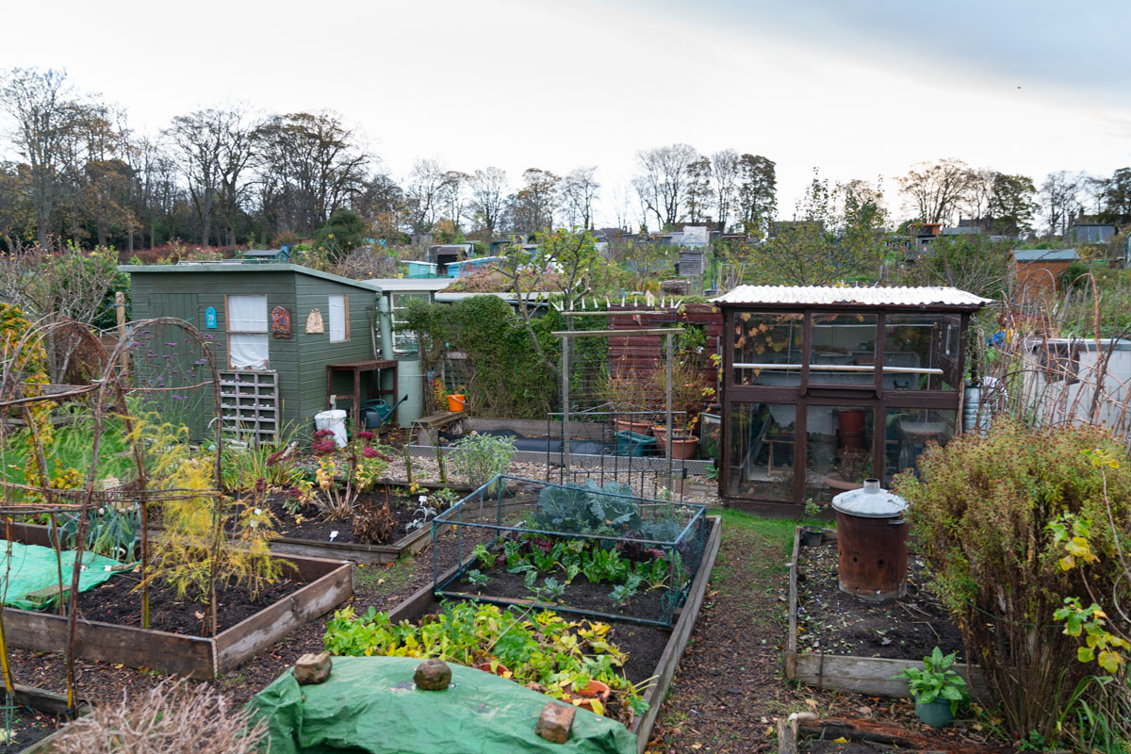
ALLOTMENTS
what is an allotment?
Allotments are small lands that people rent so they can grow their own fruit, vegetables and flowers.
They are made by dividing a large land into a small land , Allotments are usually owned by local council allotment associations or a land lord. The rent for an allotment is not to much it is as little as £8 pound a year to £125, they can often be rented for along time.
Food grown on allotments are fresh in seasonal. When gardeners grow their own food it avoids the chemicals that are sometimes, used to grow fruit and vegetables.
Allotments can usually be found anywhere, a lot of people in the UK want allotments so then they can grow their own food since they see the benefit of locally grown products.

Slide 5
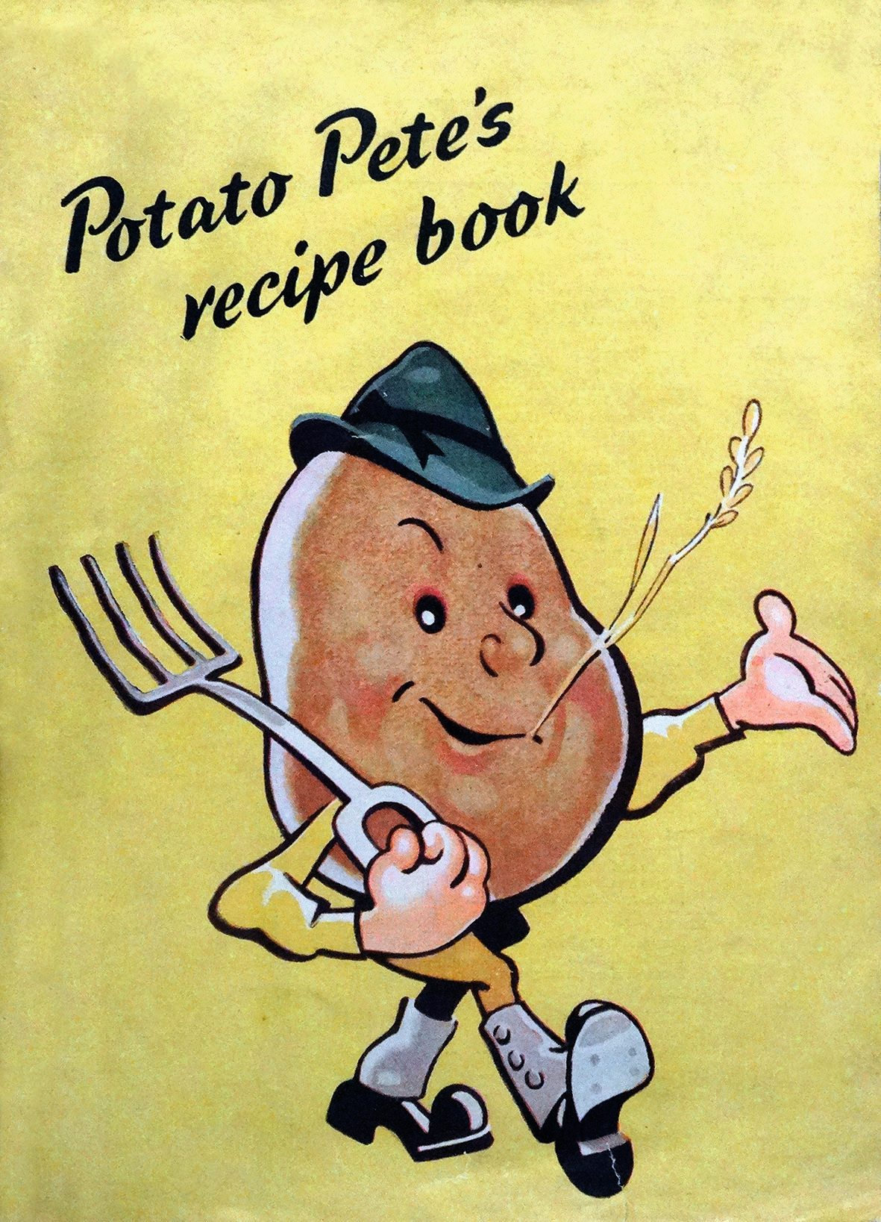
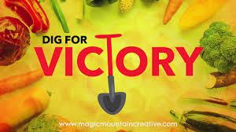
Dig for victory
The dig for victory campaign was made to encourage people to grow their own foods during the first world war. They were encouraged to grow their own food during the first world war because they were on a shortage.
Germany had blocked boats from transporting food to England, after the war lands were available for everyone to help returning soldiers and their families. The dig for victory campaign was used in the second world war as well, they only called it the dig for victory campaign in the second world war.

Slide 6
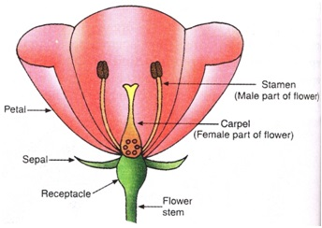
Plant life cycle
Sexual reproduction
Sexual reproduction is where pollen is transferred from one parent plant to another to create seeds that then grows into a new plant. the new plant is genetically different from its parent.
Asexual reproduction
Asexual reproduction is where only one parent plant is involved. The plant can produce an, identical version of its self called clone. There are different structures, that enable asexual reproduction such as tubers, runners, bulbs and corns.

Slide 7
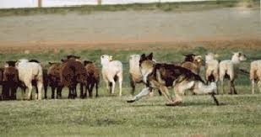
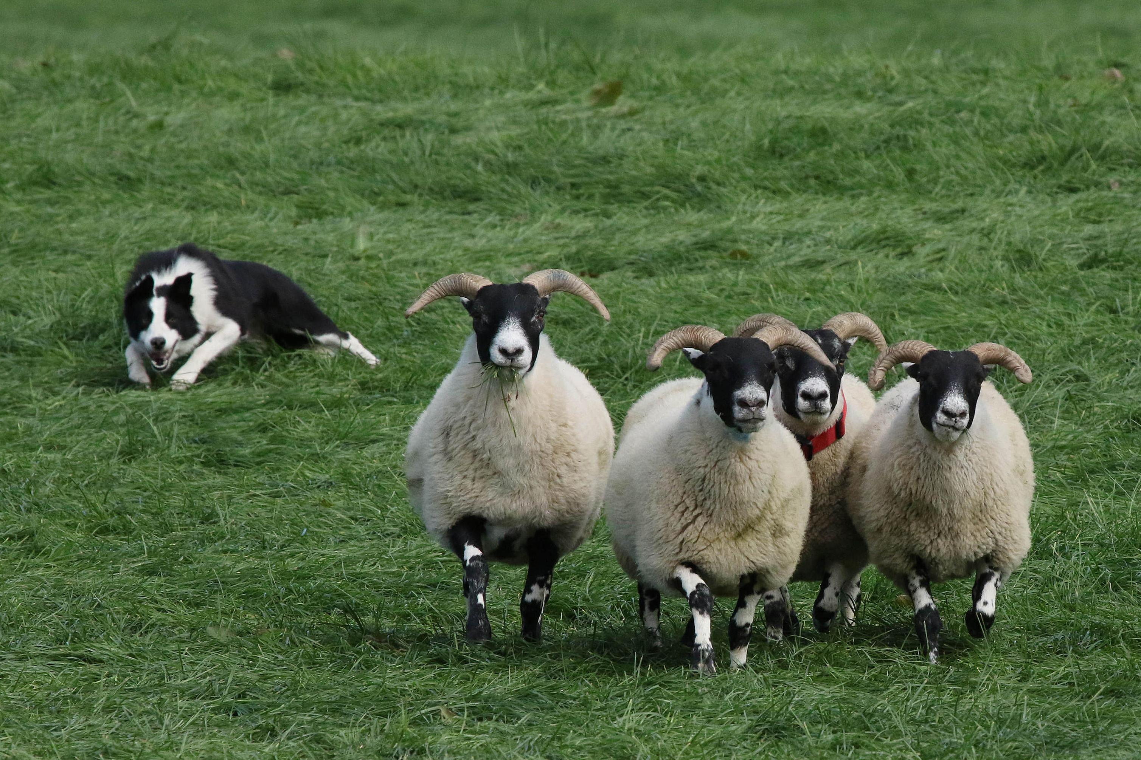
sheep dogs
Sheep dog work on farms, they round up all the sheep and other animals back into their stables. There are not that many sheepdogs anymore because of the decrease in 2018. 6000 collie pups are registered each year in the United kingdom , they continue to be the sheep herding dogs.
There are less than 1000 English sheep dogs in the united states and England combined.

Slide 8
Thank you for watching this PowerPoint!

