Slide 1
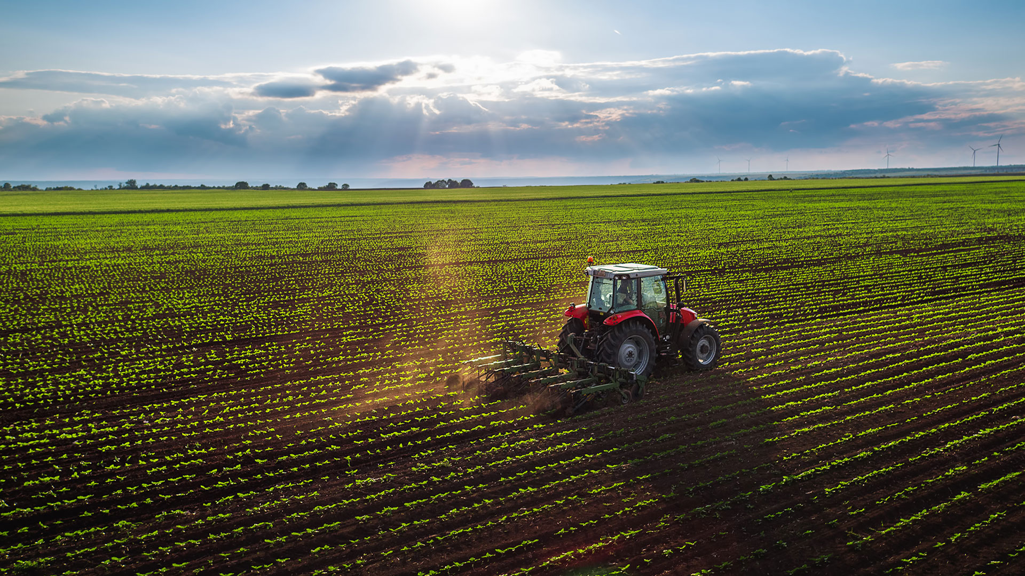
World farming
By Elsie and Sami

Slide 2
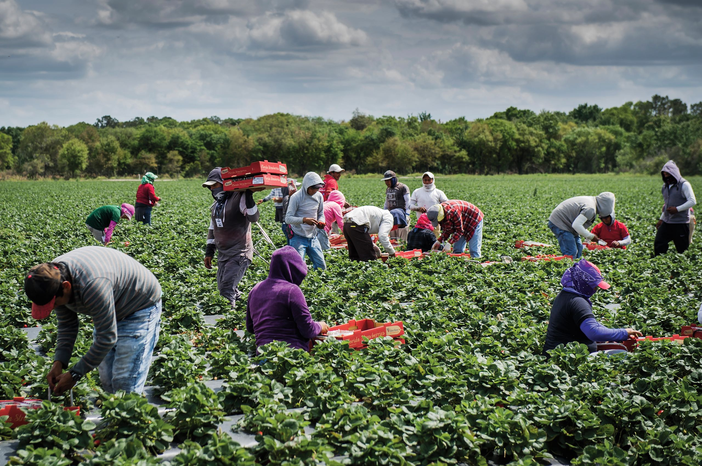
.
Farming is a business that occurs around the world. It involves growing crops and rearing livestock. Lots of people rely on farming to support their family’s well-being. Farming takes up allot of land in the UK (70%) so there are lots of people participating in the in the farming business. Read on to discover the everyday lives of workers in the farming trade.

Slide 3

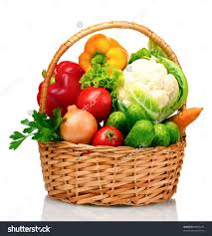
Land use in the UK
Urban land: a big piece of land occupied for cities, businesses and housing.
Rural land: the countryside or a piece of land used for forestry, national parks, farming or small villages.
Arable farming: a piece of land used to grow crops such as wheat and vegetables.
Pastoral farming: a piece of land used to raise and house animals such as cows, sheep, pigs and chickens.
Viticulture farming: a piece of land with rare soil and the right conditions used for growing grapes and turning them into wine.
Mixed farming: a large piece of land that consists of arable and pastoral farming.
Floriculture: a piece of land, or a greenhouse, used to grow outdoor and indoor flowers such as roses and daffodils.

Slide 4

Fairtrade
Fairtrade is a world wide foundation and it ensures that farmers get a good wage and safe working conditions. The Fairtrade logo (to the right) is found on many products such as: coffee, bananas and chocolate. These are the most well known Fairtrade products, however there are lots more items that are Fairtrade like tea, sugar, fruit, herbs and clothes.

Slide 5
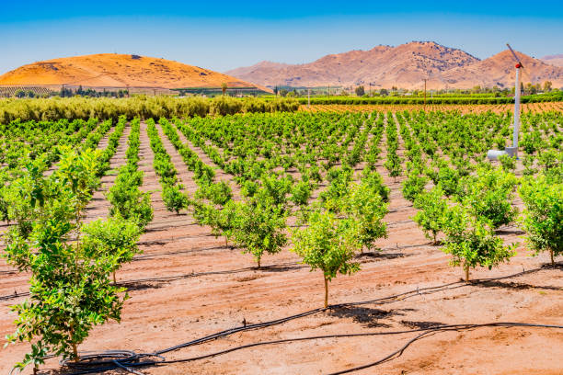
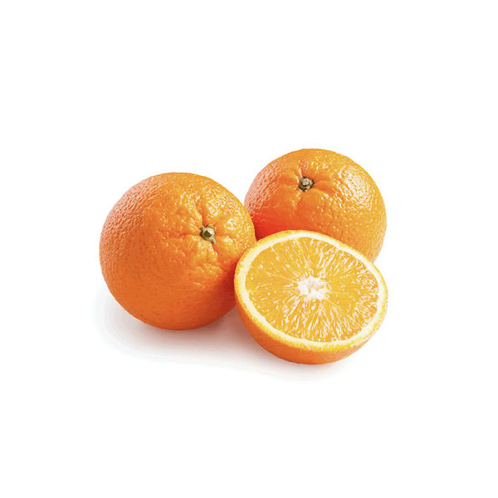
Citrus farming
California is famous for citrus farming as it has the perfect climate for the fruit to grow. The oranges need rich soil with good drainage to grow, this means the San Joaquin Valley(which is in California) is perfect for growing these delicious fruits. Some types of the oranges they grow in California are Navel oranges, Valencia oranges, Cara Cara oranges and Clementines.

Slide 6
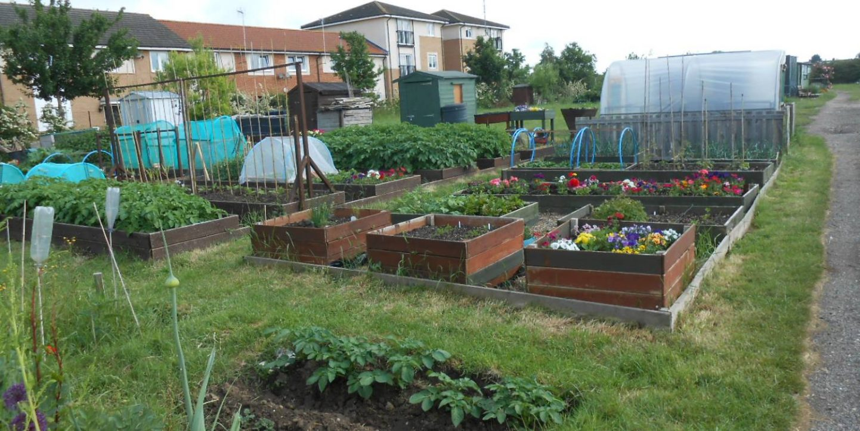
Allotments
Allotments are a small piece of land that the council split into smaller plots and then they rent them out to the local civilians of the nearest town. The council rent them out to either families or individuals, these people can grow fruit, vegetables or flowers. Once these plants have grown, the people renting them off of the council can sell their produce, give it away or eat it themselves.

Slide 7
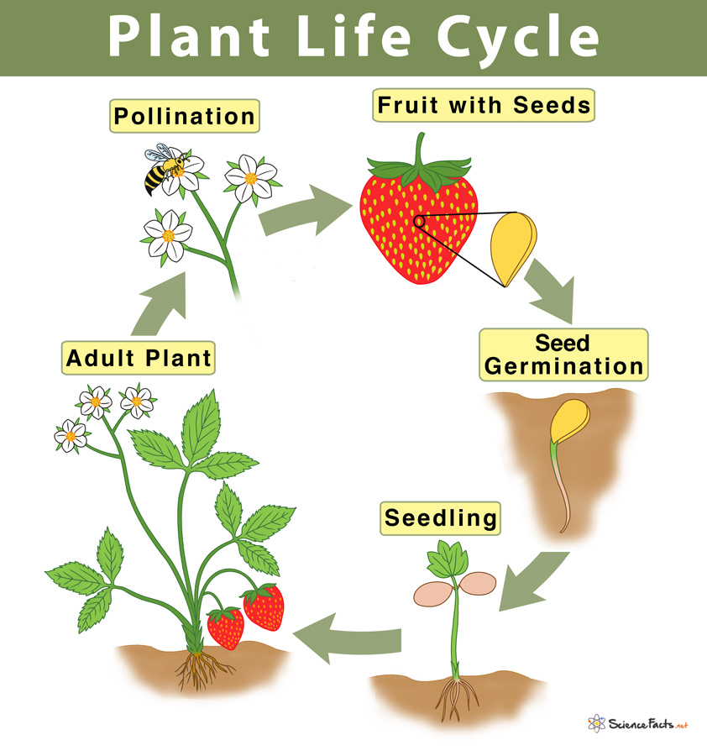
Plant life cycles
Sexual reproduction
In sexual reproduction, pollen is transferred from one parent plant to another to create seeds that grow on the new plant. The new plants are genetically different from their parents.

Slide 8
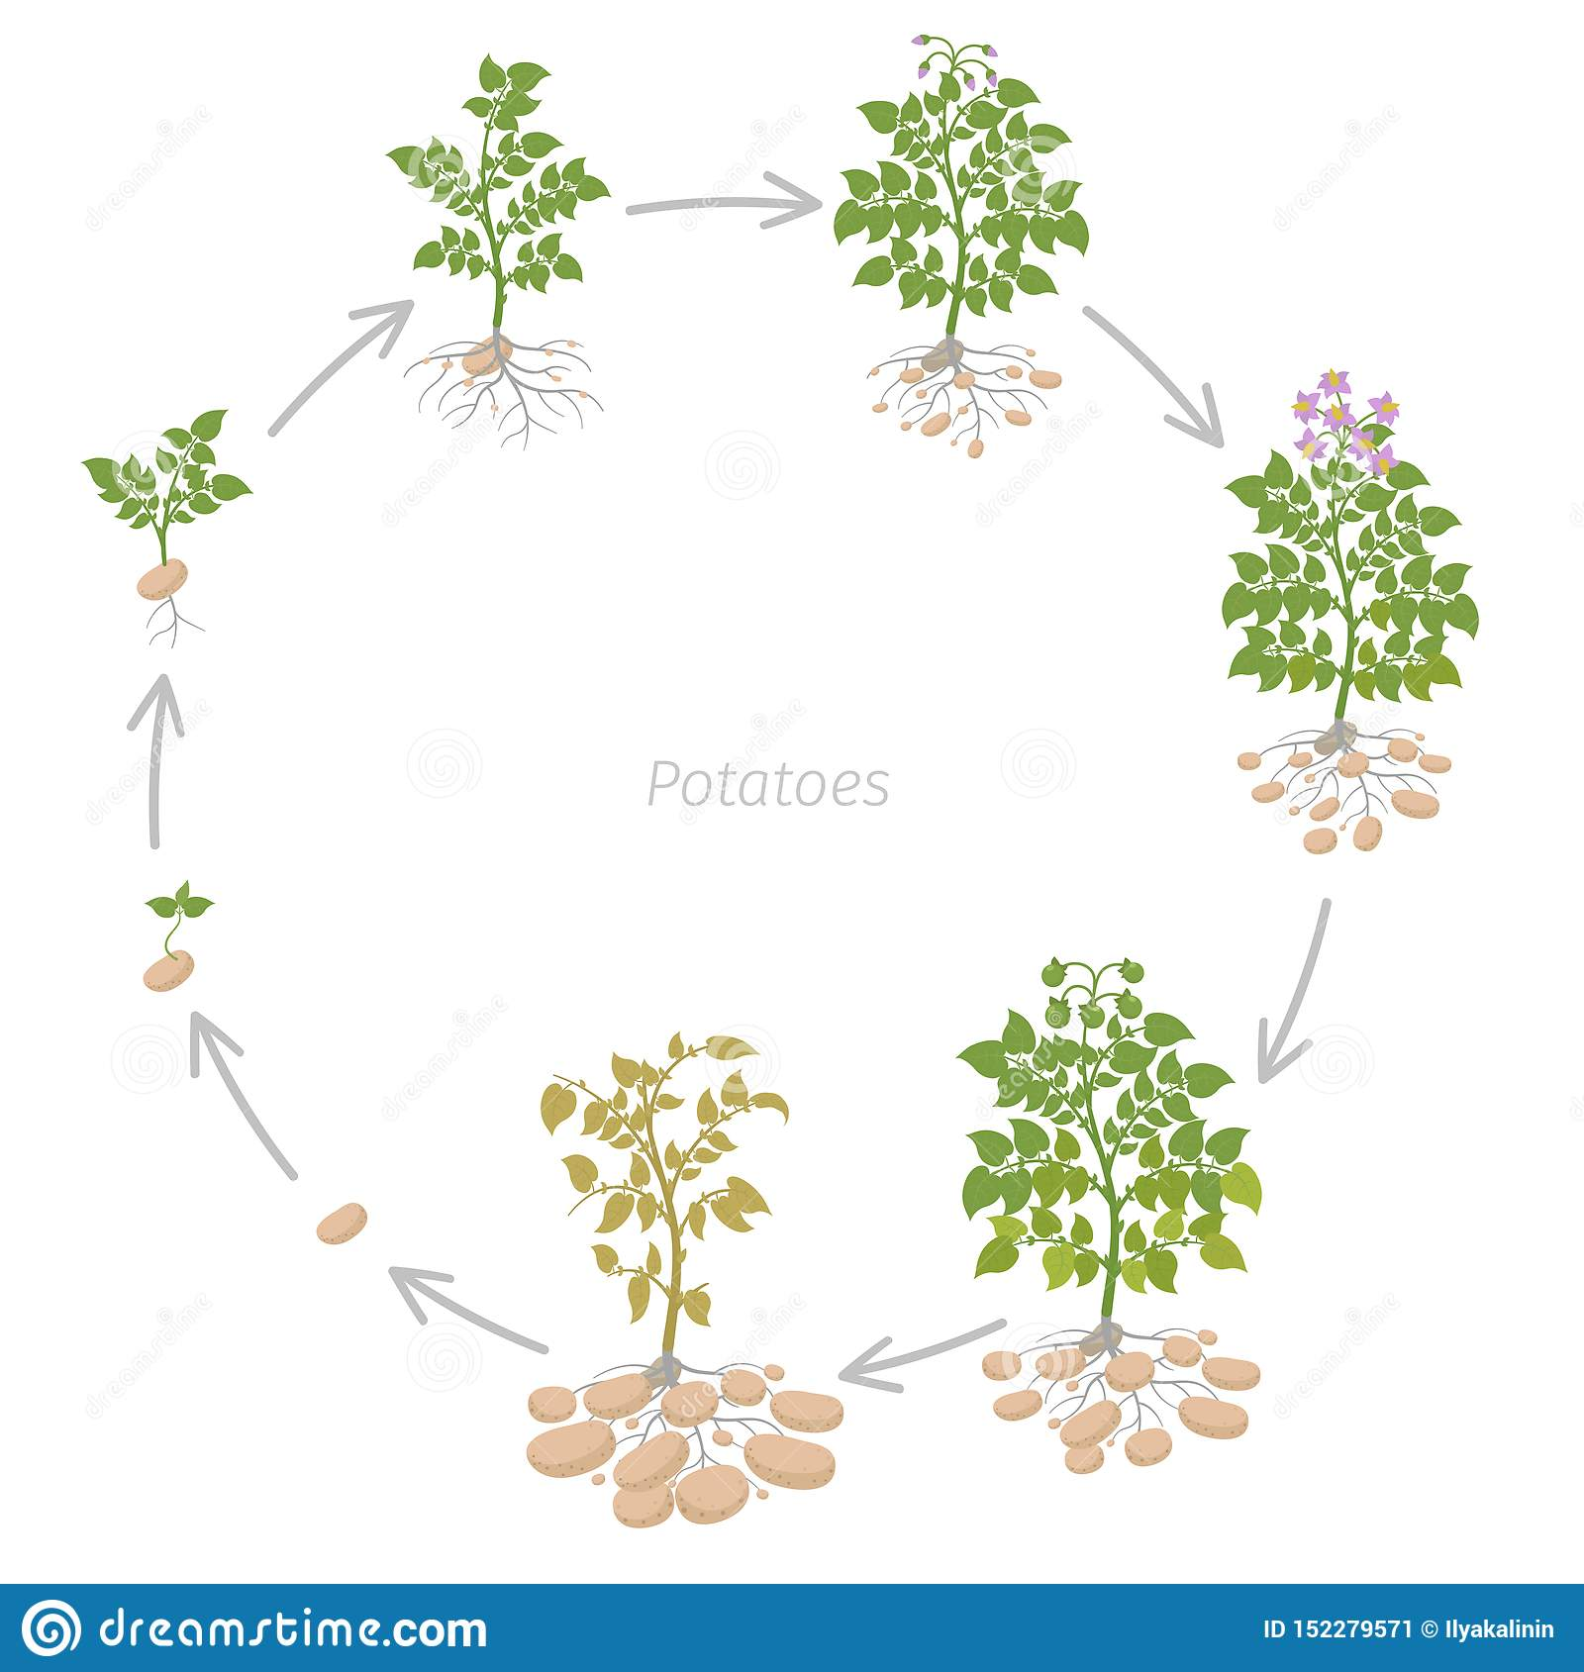
Plant life cycle
Asexual reproduction
Asexual reproduction involves only one parent plant. The plants can produce an identical version of themselves, called clones, that are genetically identical to the parent plant. There are different structures that enable asexual reproduction, such as tubers, runners, rhizomes, bulbs and corms. Potatoes are tubers and strawberries are runners.

Slide 9
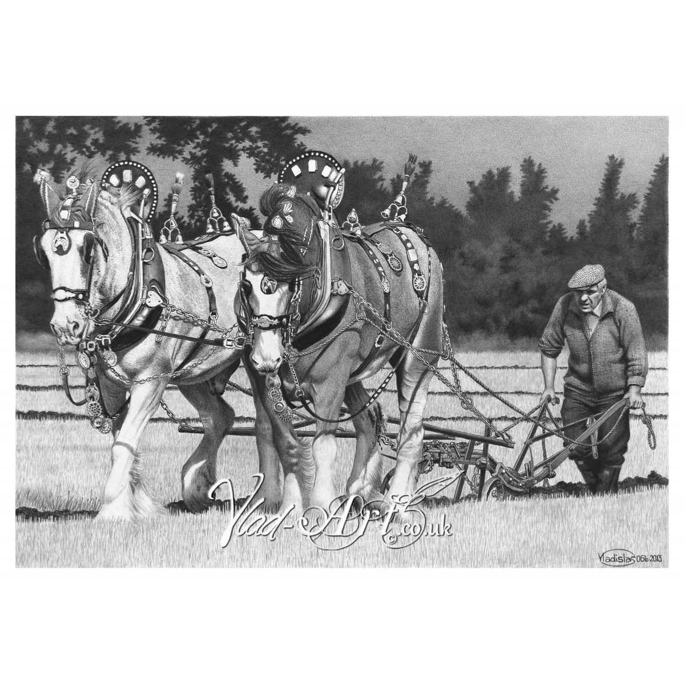
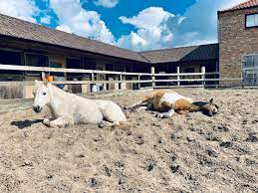
Farming techniques
Olden day techniques
Farming techniques have evolved by an incredible amount over the years. The most obvious one is that horses were used to plough the fields. They did this by pulling the ploughs across the fields. This process took a long time which led to scientists inventing modern techniques.

Slide 10
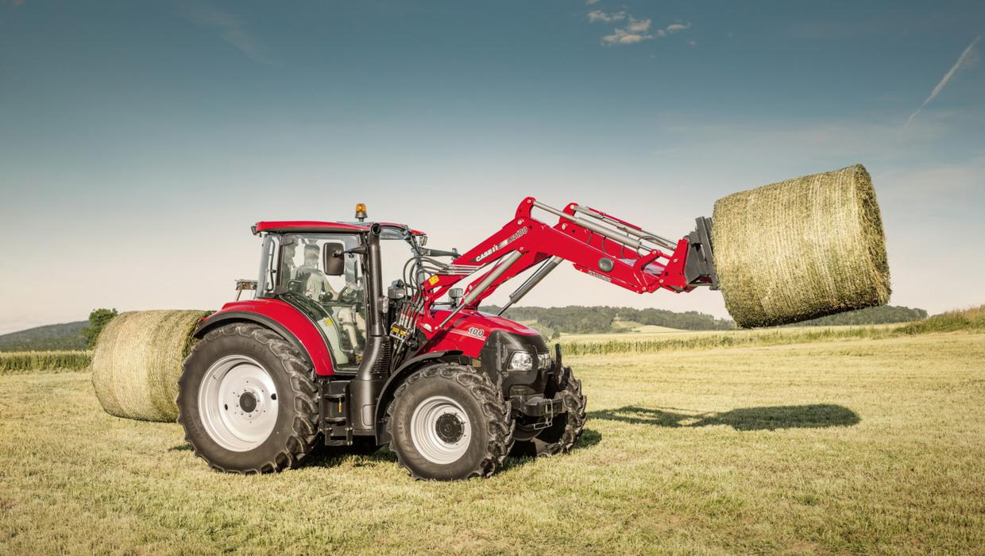
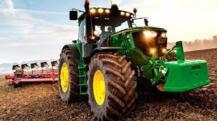
Farming techniques
Modern day techniques
Machines (like tractors, combines and lots more) have been improved over the years. This means that it doesn’t take as long as it used to. The down side to the modern techniques is that it causes a lot of pollution as the machinery is larger which means it needs more petrol.

Slide 11
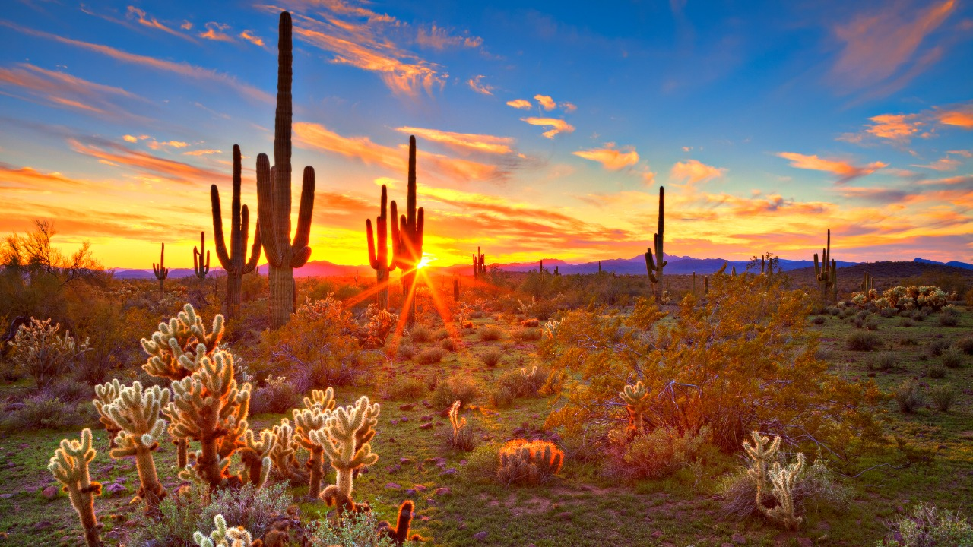
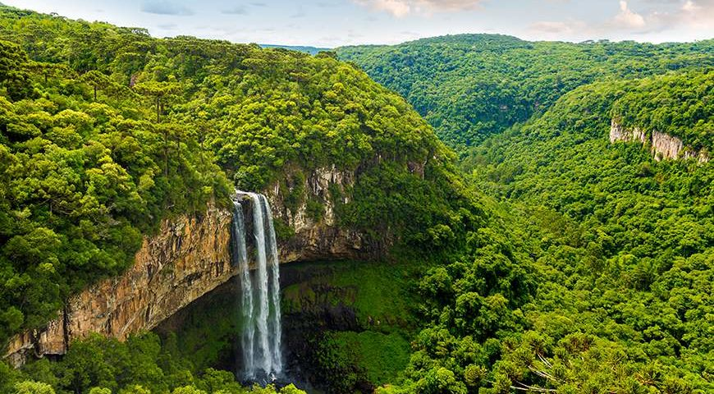
Climate zones
There are lots of different climate zones that suit different life styles.
Polar: polar zones are dry, cold places with dark and long winters. The average temperature is 10 degrees to -55 degrees.
Temperate: temperate zones are places with warm Summers and cool Winters, year round precipitation
(rainfall) with an average temperature of 0 degrees to 20 degrees.
Mediterranean: Mediterranean zones are places with hot Summers and mild Winters. With an average temperature of 15 degrees to 30 degrees.
Desert: desert zones are places with very little precipitation, high day time temperatures at 25 degrees to 40 degrees. Low night time temperatures below 0 degrees
Tropical: tropical zones are places with a wet season and dry season, which are dry and humid. The year round temperature is around 31 degrees.

Slide 12
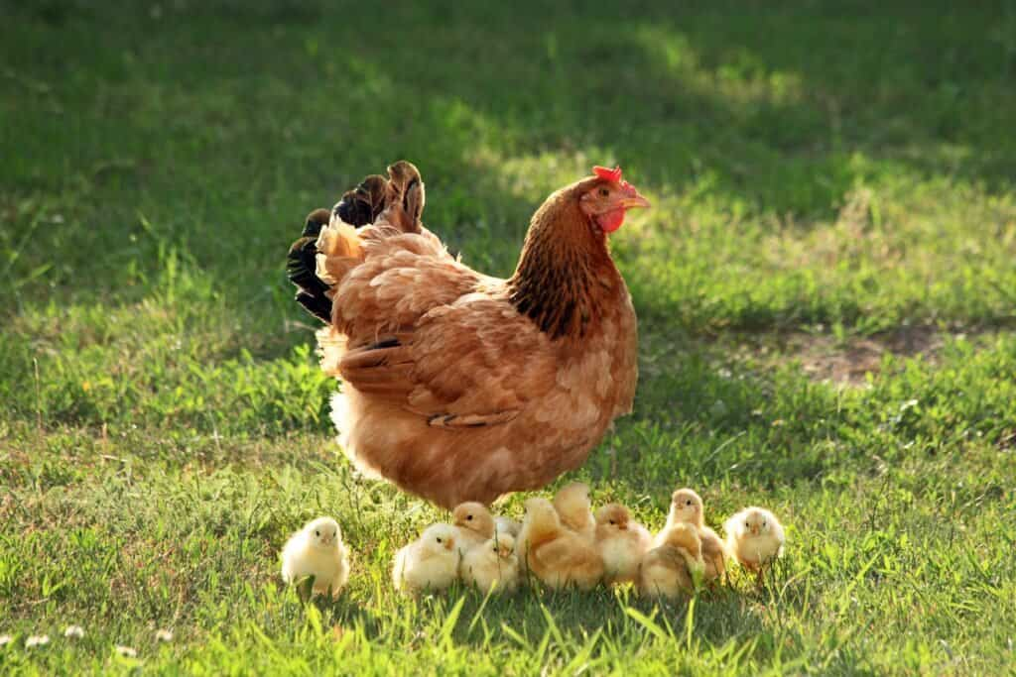
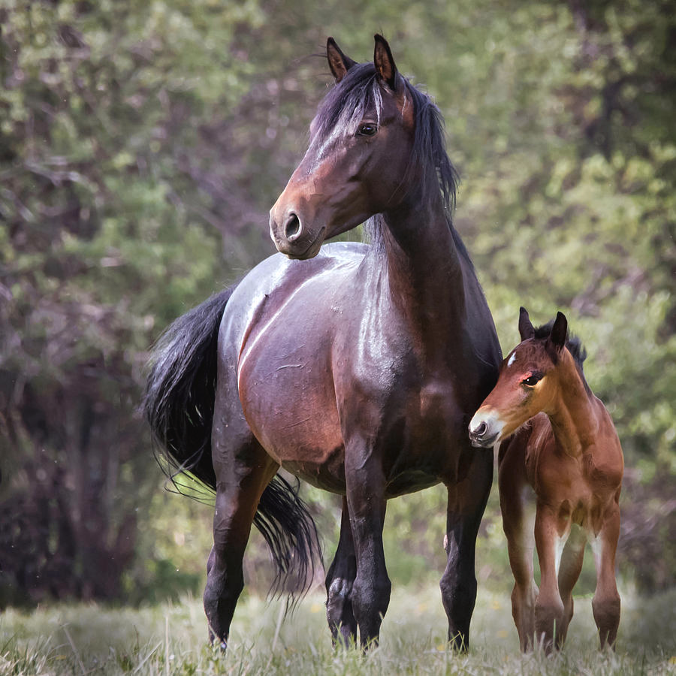
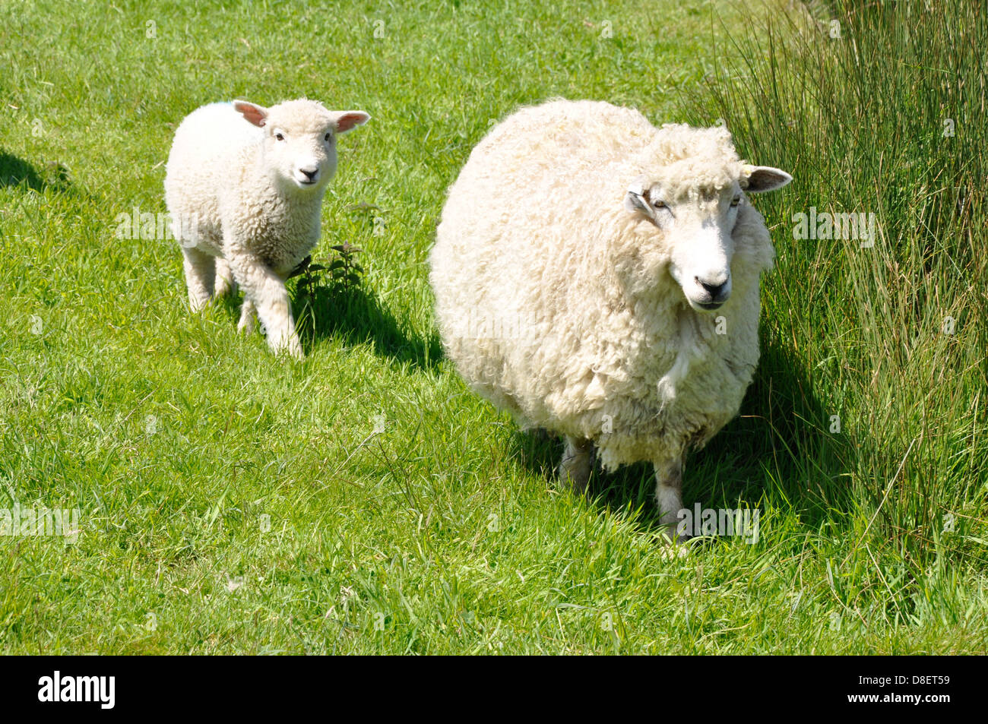
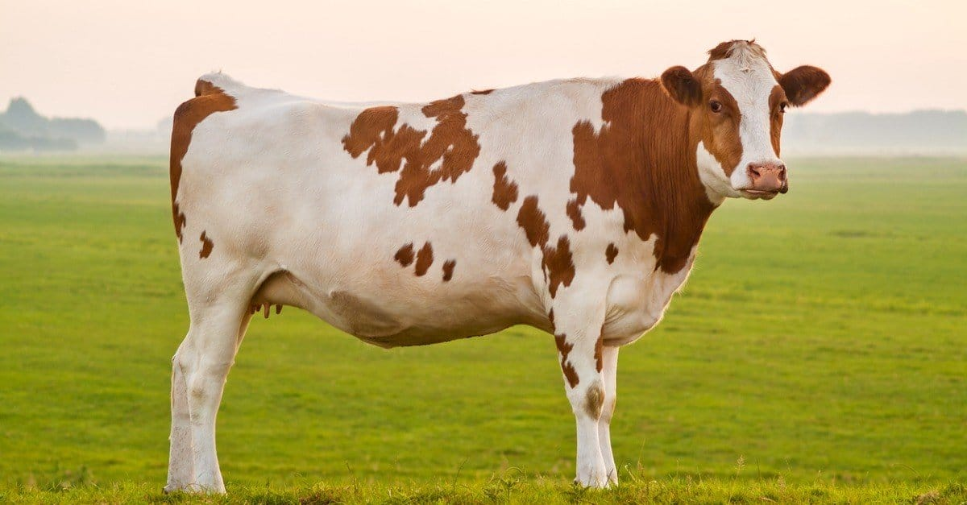
THE END!
We hope you enjoyed watching our power point

